Slide 2
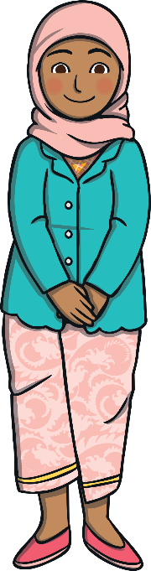
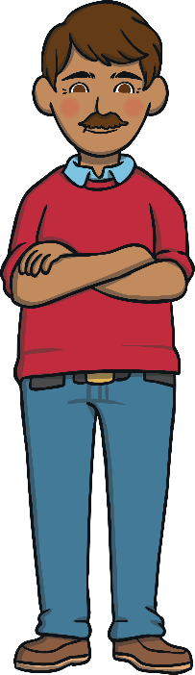
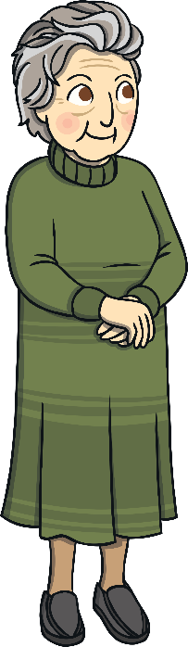
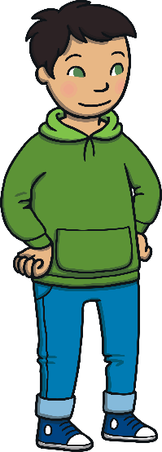
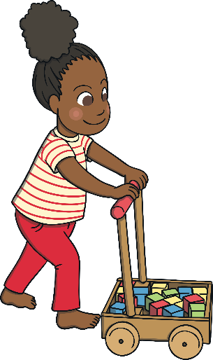
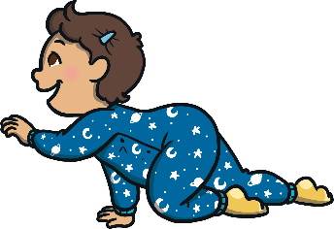
Growing Up
We are learning about how we change as we grow older.
baby
toddler
child
teenager
adult
adult

Slide 3
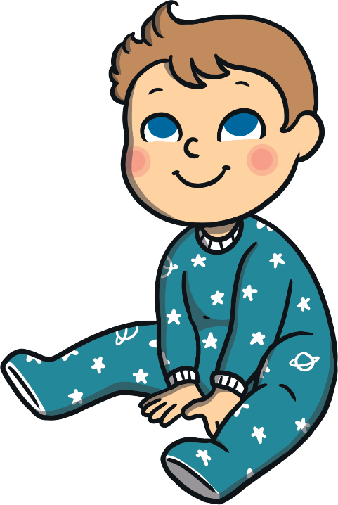
Baby
What can a baby do?
What does a baby need help to do?

Slide 4
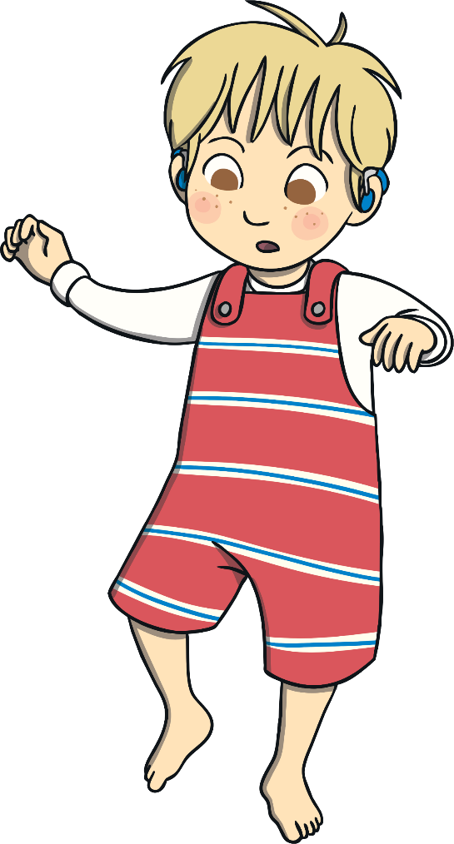

Toddler
A toddler is beginning to learn to walk. What other things are toddlers learning to do?
Toddlers start to do more for themselves without their mum or dad helping.

Slide 5
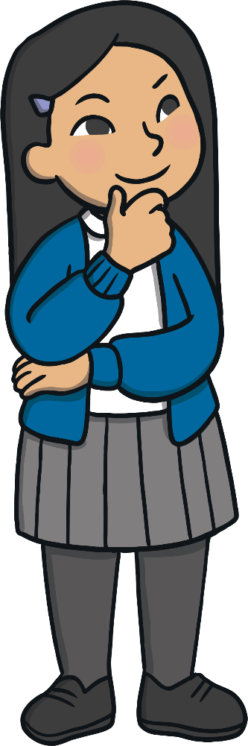
Child
All children in the UK have to go to school. What age do children start school?
As children get older, what do they get better at doing?
Think about the things you can do that you couldn’t do in nursery.

Slide 6
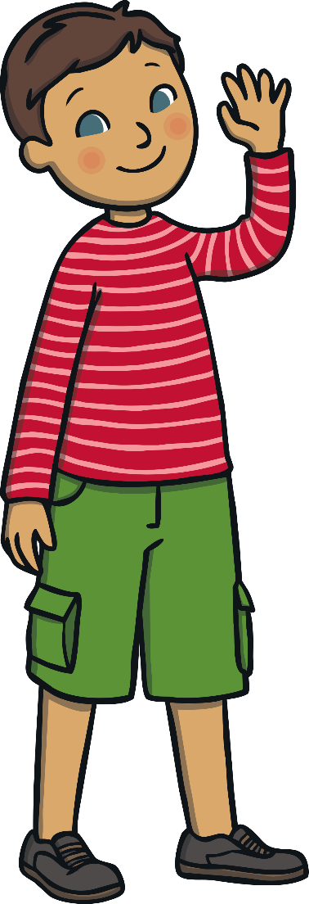
Teenager
A teenager is anyone aged 13 to 19 years.
How does your body start to change when you become a teenager?
What age can teenagers leave school?

Slide 7
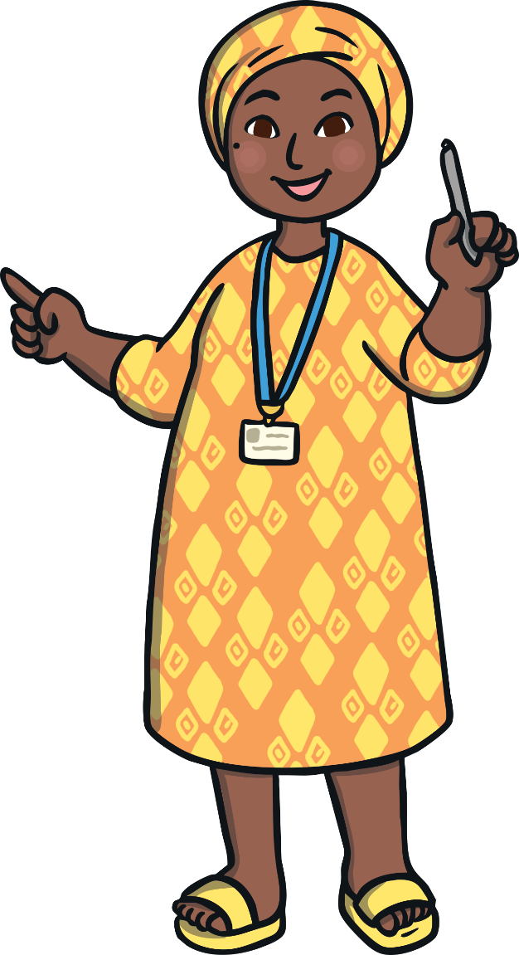
Adult
When a person becomes an adult they usually start work. Why do adults need to have a job?
What jobs do the adults in your family do?
What job might you like to do when you grow up?

Slide 8
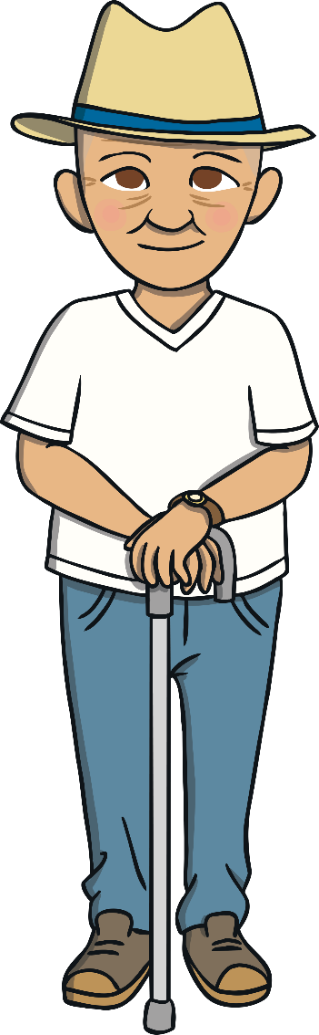
Elderly
When people get older they eventually stop working. Why do elderly people need to stop working?
What could some elderly people do with their free time?
How could you help an elderly person?

