Slide 1
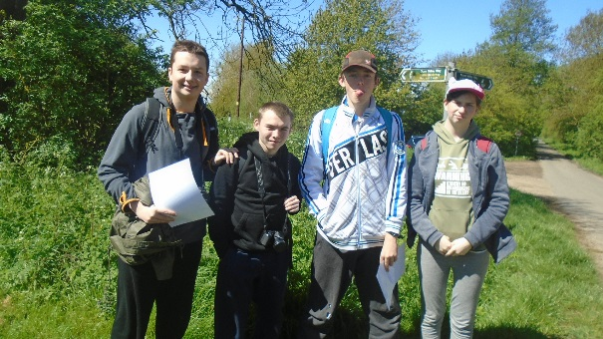
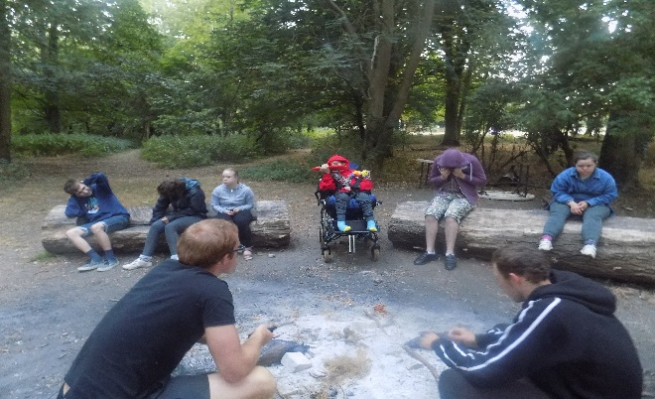
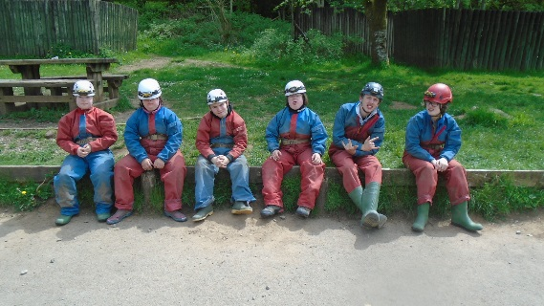
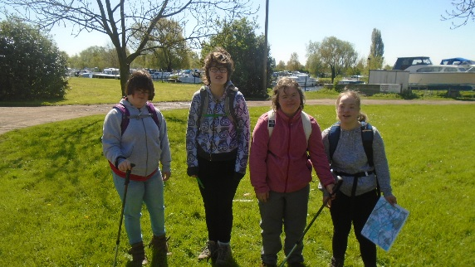
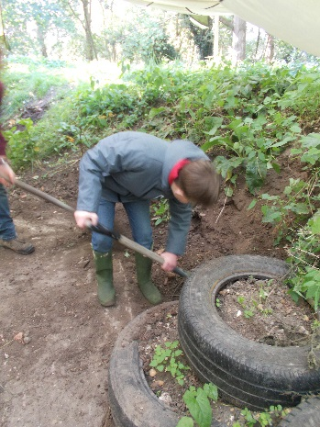
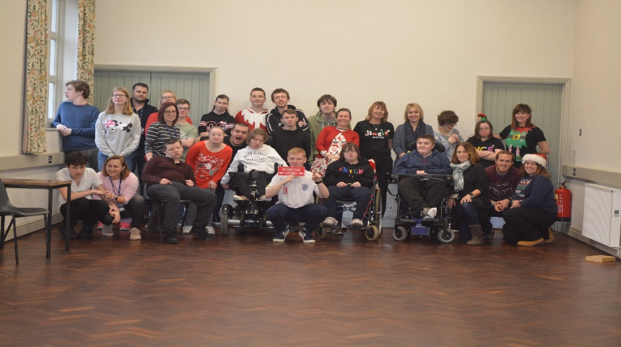
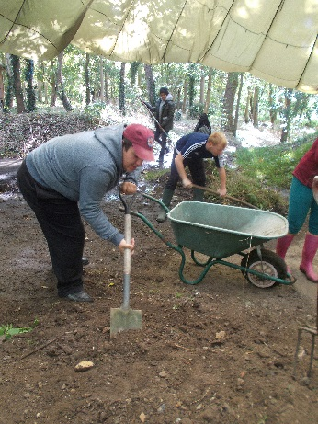
GET READY FOR YOUR 6TH FORM
JOURNEY TO BEGIN….

Slide 2
What to expect when you come up to 6th form
Courses on offer
Sports Leaders Award
Dof E
Clubs
Work Experience
Social life in 6th form

Slide 3
Mission Statement
We aim to offer an individualised learning package, designed to equip learners with the transferable skills and knowledge needed for their adult life.
We aim to develop confident and compassionate students who are effective and successful learners. Encouraging them to care and respect others as well as caring for and respecting themselves.
We offer a holistic approach , working within a multidisciplinary team, where all communication and individual needs are catered for and addressed.
We strive to provide a total communication environment; where individualised communication styles are celebrated and developed.
Staff are dedicated to assisting students to be : ‘Happy, Confident and Achieve’; enabling students to take an increasing responsibility for their own learning, developing positive personal strengths.
We promote a safe, stable and happy environment where students learn effectively and behave appropriately, so that they may become more autonomous and reflective.
We provide a blended curriculum, which incorporates a significant work based learning aspect and links with local post 19 provision.
We are continuously looking for ways to increase students independence, self-esteem and wellbeing. We aim to widen their experiences and opportunities to enable students to gain a sense of community, self-worth and reflect on their own growing strengths.

Slide 4
The Curriculum
Transition is at the heart of the post-16 curriculum, and we strive to provide an individualised learning pathway in line with the Foundation Learning tier whilst preparing students for their unique post-19 destinations.
Our range of subjects and learning experiences are aimed to develop transferable skills, extending learning outside of the classroom.
Students in 6th form are highly involved in charity and community events to develop a range of skills , knowledge and experience which is transferable to the world of work.
We offer a curriculum that has individual pathways running throughout, ensuring a range of interventions to provide CEIAG, building on knowledge taught at each stage.
Our learning packages are flexible and designed with the students thoughts and ideas in mind, suiting their own particular needs. We therefore strive to offer our students social, work and learning opportunities and experiences that enable them to grow into confident young people.
Blended learning takes place at Granta School, including Local colleges such as Cambridge Regional College and Saffron Walden County High Farm.
Work experience is an important part of our study programme in 6th form. We accredit work related learning within the curriculum. Vocational learning includes outdoor learning, enterprise and food technology, which provide opportunities for our students to grow and sell products. We grow fruit and vegetables , we make hanging baskets to sell, we hold a soup café for staff in the spring term using our home grown vegetables to make the soup using the skills taught in food technology. In enterprise we make items to sell related to the time of year, we also have a printing enterprise and make tea towels, bags and aprons to sell.
We offer our students the opportunity to undertake high quality and meaningful work experience as part of their post 16 education. We have links and offer placements for example with Prospects Trust, Rowan Humberstone, Ickworth Park, Audley End, REACH Foodbank, Linton Zoo, Addenbrooke’s cafe and local businesses. These experiences give the students the opportunity to enhance the skills developed within the school environment.
During year 14 students attend a local college programme as part of their transition, which prepares them for the next step into further education, whilst developing new skills, knowledge and also experience being in a new setting.

Slide 5
The Curriculum
There are two classes based in 6th form: Darwin and Pemberton
Students have the opportunity to take part in some or all of the following depending on suitability:
OCR Life and Living Skills Entry 1,2 and 3
Duke of Edinburgh Award: Bronze: skill, physical, volunteering and a 2 day 1 night expedition locally) Silver: skill, physical, volunteering and a 3 day 2 night expedition outside of Cambridgeshire) and Gold: skill, physical, volunteering, expedition 4 days 3 nights in wild country and a residential).
Functional Skills: Maths, English and ICT
Young Sports Leaders Award in addition to specific sports, ie. Boccia leaders award, Panathlon leaders award
BTEC Level 1 and 2 Home cooking course
Bike ability Level 1 and 2
AQA PSD
Arts Award
Part of our blended learning package provides learners with a taster of post-19 provisions appropriate to their individualised needs. These experiences are then used to create a unique transition plan with learners and families. We therefore work closely with ANPAS, the transitions team and local colleges to enable a smooth transition to adult life.
Possible post-19 destinations include further Entry level, Level 1/ 2 courses at local colleges, placements at local social firms and adult social care provisions and full time employment.
(There is an Appeals procedure if parents do not agree with the Internal Assessor for BTEC awards )

Slide 6
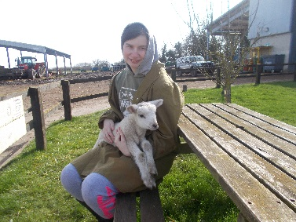
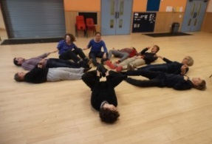
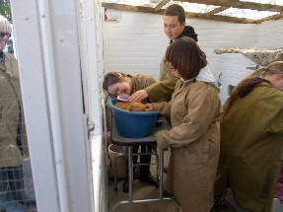
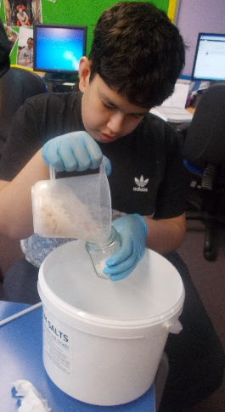
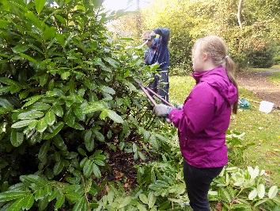
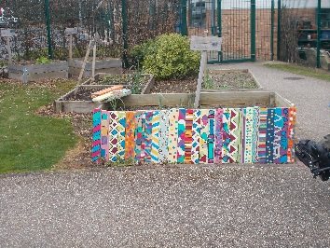
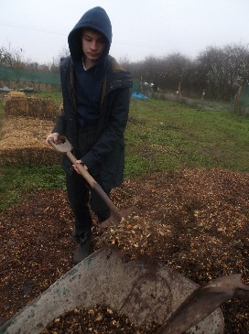
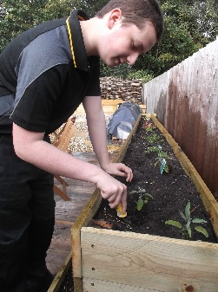
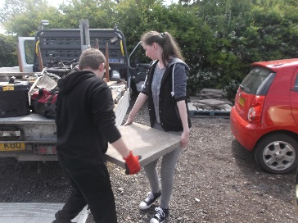
OCR Life & Living Skills
The course may include:
*Personal Skills & PSD
Horticulture
*Arts & Craft Independence Skills
*Communication Media
*Environment & Community
*Home Management ICT World of work Numeracy Music Animal care
* Sports& Le
isure Manufacturing World related learning
Sports & Leisure Enterprise

Slide 7
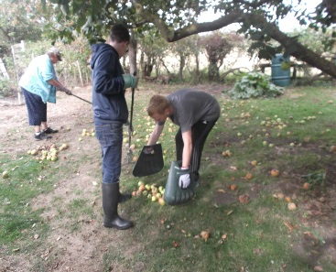
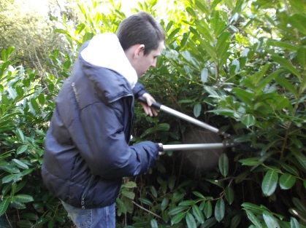
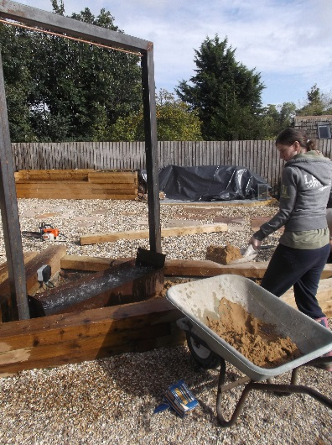
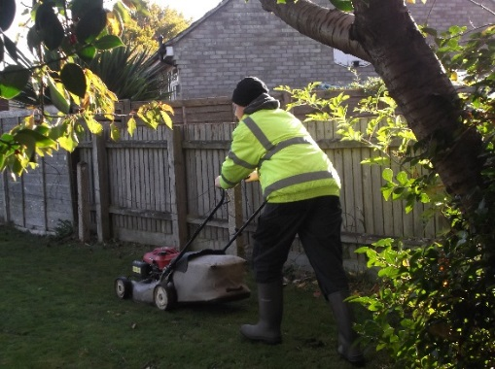
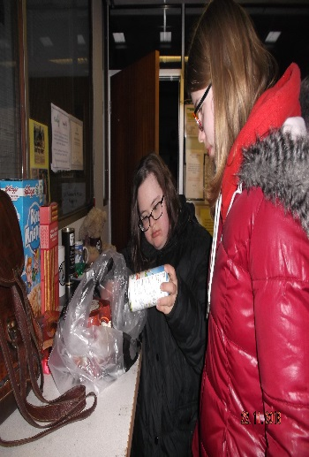
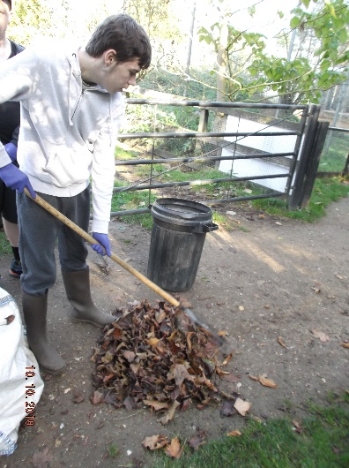
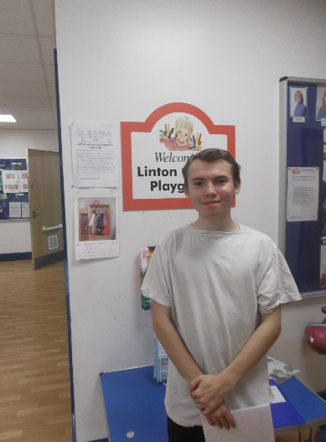
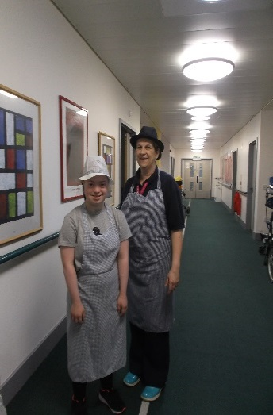
Work Experience
Work experience is an important part of our study programme in 6th form.
Working in partnership with local social firms and businesses students have the opportunity to take part in meaningful work place visits, work shadowing, work experience and volunteering. We always visit the work placements as a group so that students are able to make an informed choice of where they would like to go in the future.
We also look to develop a students interests and hobbies if possible.
Students tend to go with individual support, 1 adult will usually accompany 2 or 3 students, or some students will be able and confident enough to go on their own. If students are going unsupported we will expect a placement near where they live. We will also support students in travel training to enable them greater independence if appropriate.
Social Firms : Prospects Trust, Darwin Nurseries
Local businesses: This year we have had students attend the COOP, Waitrose, Local playgroup, Linton Zoo, Addenbrooke’s café, Garden Centres and local libraries
Charity Shops and the local Foodbank

Slide 8
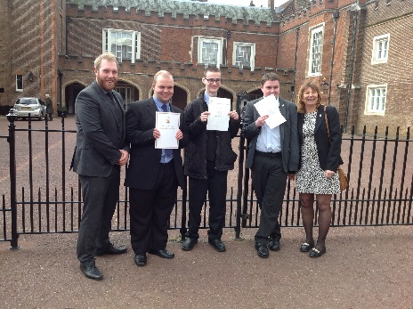
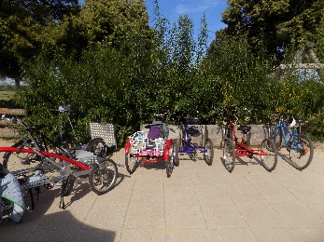
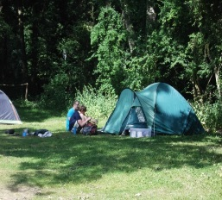
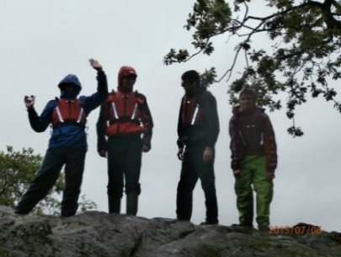
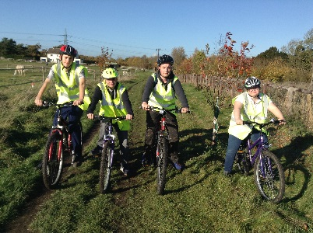
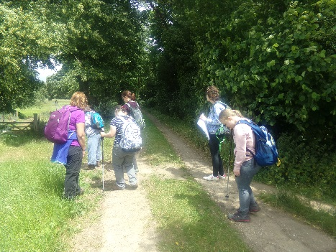
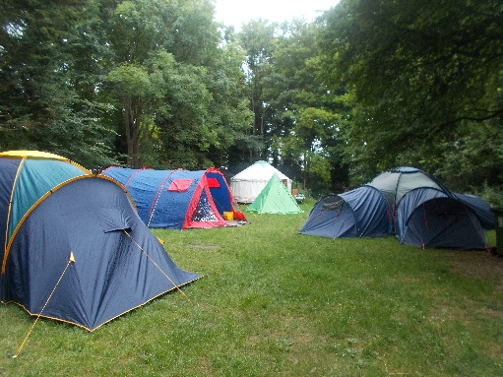
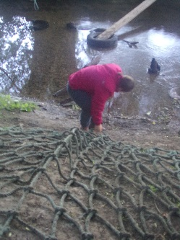
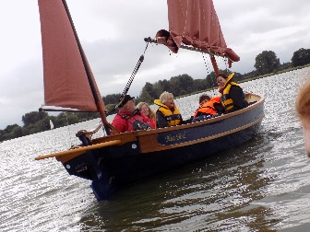
Duke of Edinburgh
Award Scheme
As of September 2010 Granta School has been able to offer its students the opportunity to achieve the Duke of Edinburgh Award at Bronze, Silver and Gold level. Each level increasing in length of service. The award is designed to teach young people aged 14 and above independence, social skills and determination to achieve and take on challenges, building character, confidence, leadership and resilience.
To date, Granta has offered this award to 43 students in total. The bronze to 33 students, the silver to 30 and the gold to 17 students.
The Duke of Edinburgh team is led by Julie Lloyd and Yvette Vincent and is ably assisted by Marta Policht and Laura Marsh. These leaders have helped the students set aims in each of the following areas:
Volunteering: Gives students the chance to make a difference to peoples life's using their skills and experience to help the local community
Physical: Involves taking art in a pursuit that requires a sustained level of energy and physical activity.
Skills: Challenges students to improve a skill they already have or to learn a new one.
Expedition: Planning, training for and completing an adventurous journey in the UK or abroad.
For the Bronze group this is an overnight camp and two days activity, The silver have 3 days of activity and two nights camp and the gold have 4 days activity and 3nights camping.
Groups have been to centers and campsites around the UK, including Rendelsham forest, Dorking, St.Ives, Lake District and Abington woods.
The programme is always designed to be full of activities and projects which excite and challenge the students, improving their self esteem and confidence. They pick up new
experiences, friends and talents which stay with them fro the rest of their lives.
New skill give them the confidence. New skills give them the confidence and an attitude
that is sought after by future employers and colleges.
Students get recognition for independent thinking and
organizing themselves.
Students learn that they can make a difference to other
Peoples lives and their communities

Slide 9
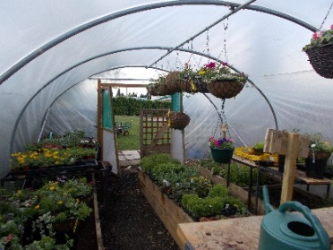
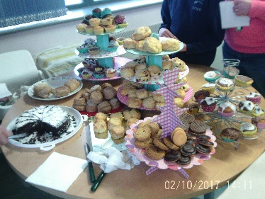
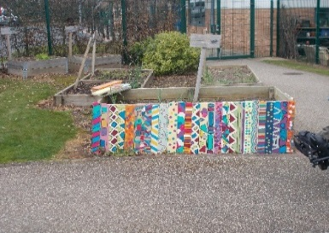
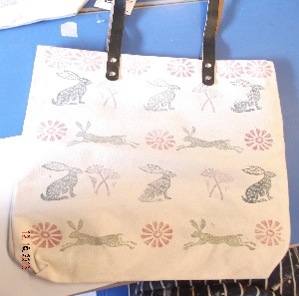
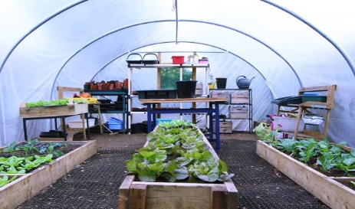
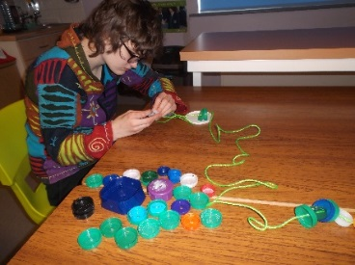
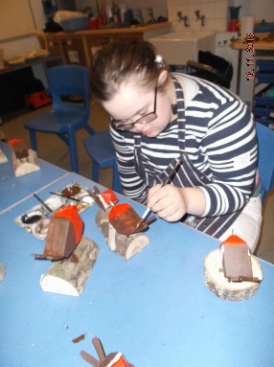
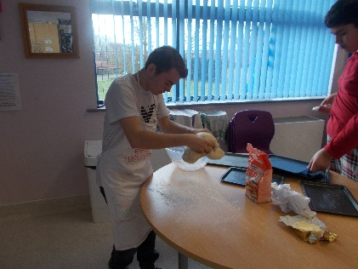
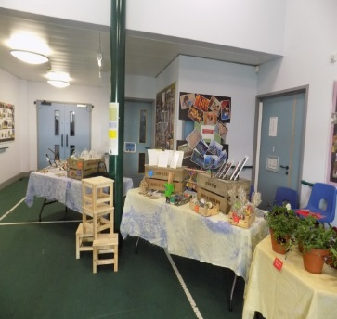
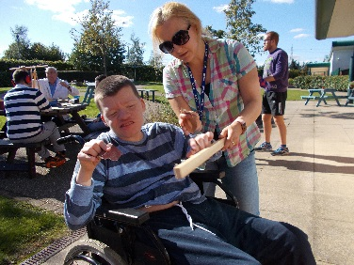
Mini- Enterprise
We accredit work related learning within the curriculum. Vocational learning includes outdoor learning, enterprise and food technology. which provide opportunities for our students to grow and sell products. We grow fruit and vegetables , we make hanging baskets to sell, we hold a soup café for staff in the spring term using our home grown vegetables to make the soup using the skills taught in food technology In enterprise we make items to sell related to the time of year,. We also have printing enterprise and make tea towels, bags and aprons to sell. Staff and students also attend a local village coffee morning regularly to sell our products. We have a stall at the school fayre in the summer and winter to sell our goods and the students help to run this.
Planting and Selling herbs, fruit, vegetables and
flowers from our very own garden, polytunnel and raised beds.
Collecting 2nd hand items to restore and sell
Café- students in 6th form make
cakes and savouries to sell in a café that they run termly for charity
Cake Sales
Car Valeting
Soup making for staff lunches, we use the vegetables we grow to
make soups for staff in a café during the spring term
Art and Craft products

Slide 10
Sports Leaders Award
Taught in curriculum time during PE
Develops the following skills:
  Communication
  Teamwork
  Organisation
  Planning & Evaluation
  Self confidence & self esteem
  Students have the opportunity to assist at lunchtime sports clubs and run intra school festivals for the whole school
  Plan , organise and run sports days, KS Panathlon festivals across the school, helping in class PE lessons
  Young leaders also have the opportunity to train with step into sport, Boccia England and Panathlon level 1 & 2
  All students receive a T-shirt, log book, whistle and lanyard

Slide 11
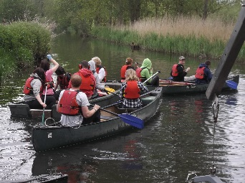
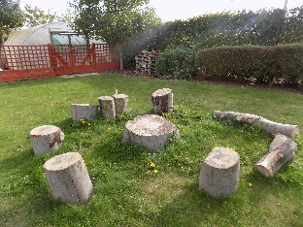
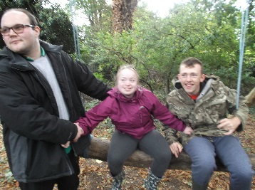
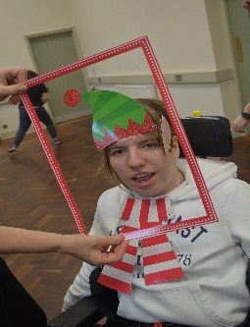
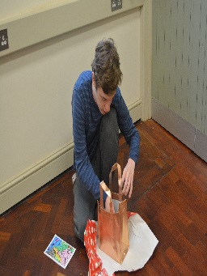
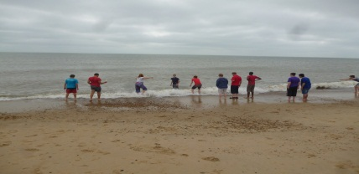
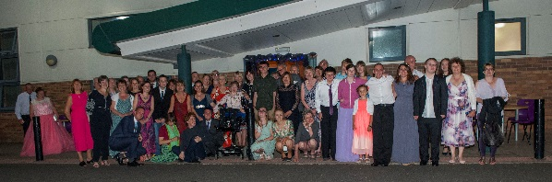






Social life in 6th form
An opportunity to develop independence and social skills.
Activities week taking part in a variety of activities
chosen by the students have included Biking at Milton Country Park,
visit to the seaside, film making with Total Arts, The tubes at
Parkside, making a music wall and our “This is me” Video with Wayne
Barrow. (see home page for video).
Leavers PROM
Regular visits to local community facilities:
cafés, supermarkets, library, fitness gym and local parks and gardens
Termly whole group celebrations: which have included bowling,
meals out, ice skating, roller blading, theatre or cinema
Christmas party - off site
Lunchtime clubs: include sport (boccia, curling, table top games, basketball, football ) craft, puzzles, board games, Wii fit/play station, music(drumming, guitar and singing), sensory/light room, colouring, Lego, signing

