Slide 1
Week beginning 13th July
Oliver’s Vegetables
Watch the story on YouTube
Revisit the days of the week
Look at some vegetables
Learn the vegetable signs
Make a vegetable face
Print a vegetable face

Slide 2
How to sign the days of the week.
Tap 3 fingers onto palm twice.
Tap index finger to side of palm twice.
Thread fingers together twice.

Slide 3
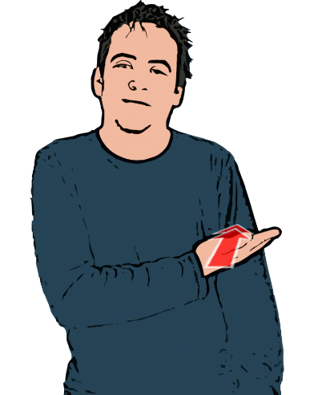
Tap index finger to side of palm then slide your hand across flat palm.
Place 2 fingers over 2 fingers and circle twice.
Open hand taps upper arm twice.
Open hands tap each other palm to palm twice.

Slide 4
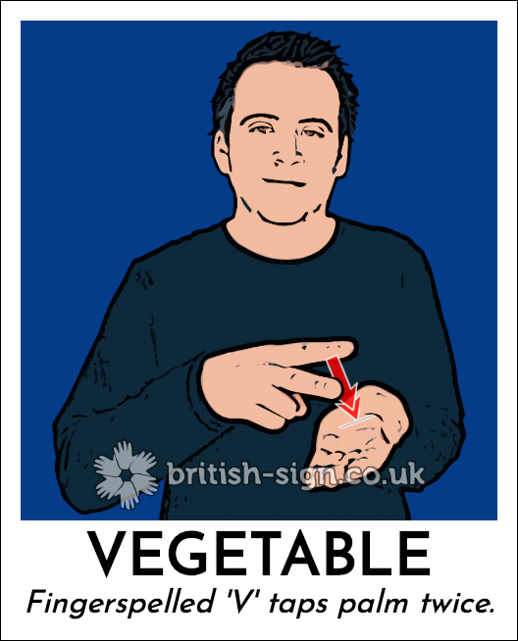
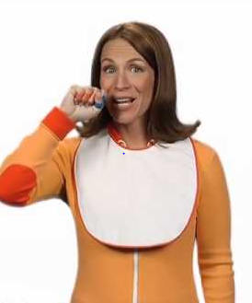
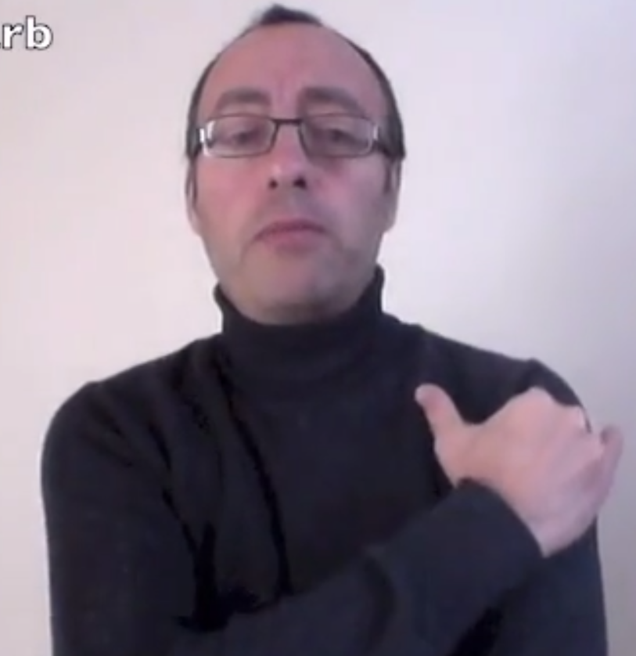
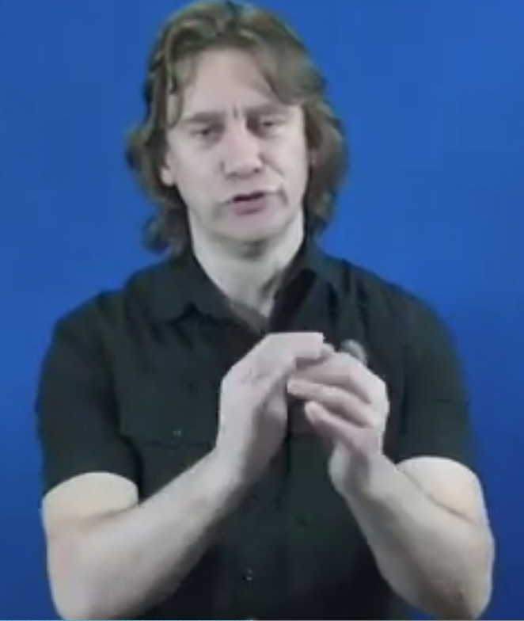
Carrot
Rhubarb
Cabbage
Twist hands back and forth to show the layers of a cabbage
Clench fist and twist forwards
Move hand up arm from elbow to shoulder
Peas
With a clenched fist wrapping the thumb pop your thumb up.
Potato
Pull index finger across top of fist like you are peeling a potato
Spinach
Sign vegetable and say Spinach
Beetroot
Sign vegetable and say Beetroot
Find BSL videos at:
signbsl.com

Slide 5
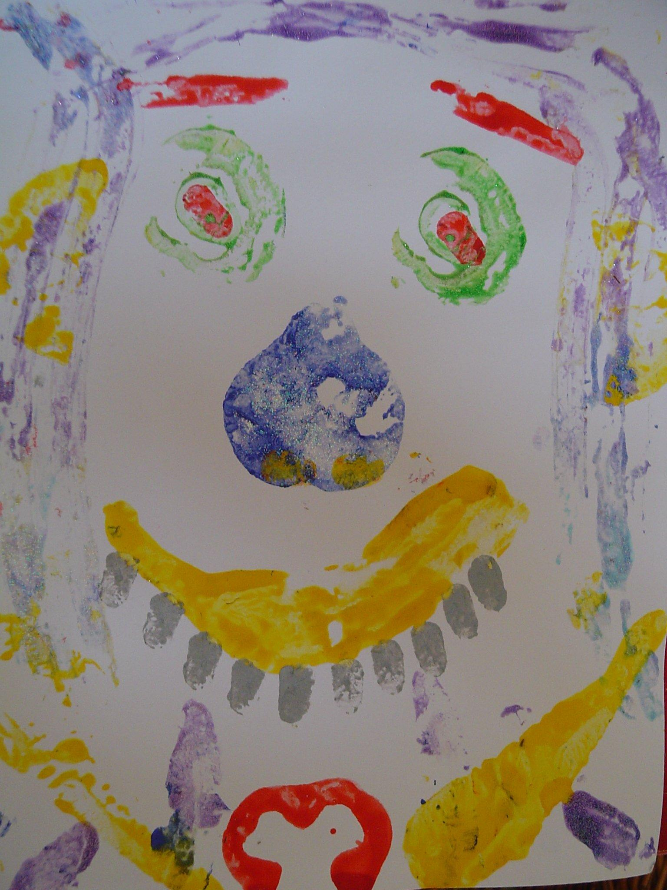
Vegetable Hunt
Use easy to find vegetables
Foe example:
Carrots
Tomatoes
Potatoes
Pepper
Place vegetables around you garden or around the house if more appropriate and go on a vegetable hunt with your child using the signs you have learnt.
When you have collected them sit down and taste the edible ones (NOT the POTATO)
You can then use your vegetables to print a vegetable face.
An example question:
Which vegetables would you use for the eyes?

