Slide 1
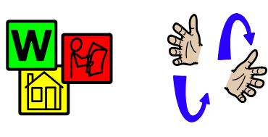
Hi Pandas!
This week I would like you to use a symbol or a sign to make a request.
Maybe you might pick a symbol from two to say that you want porridge for breakfast and not toast.
Or, you might look at my signing video and sign ‘pasta please’ for your lunch.
Please do let us know how and what you asked for
and if there are more symbols you would like us to send home.

Slide 2
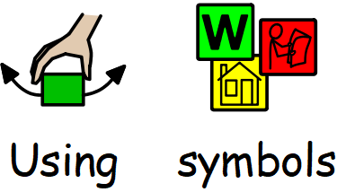
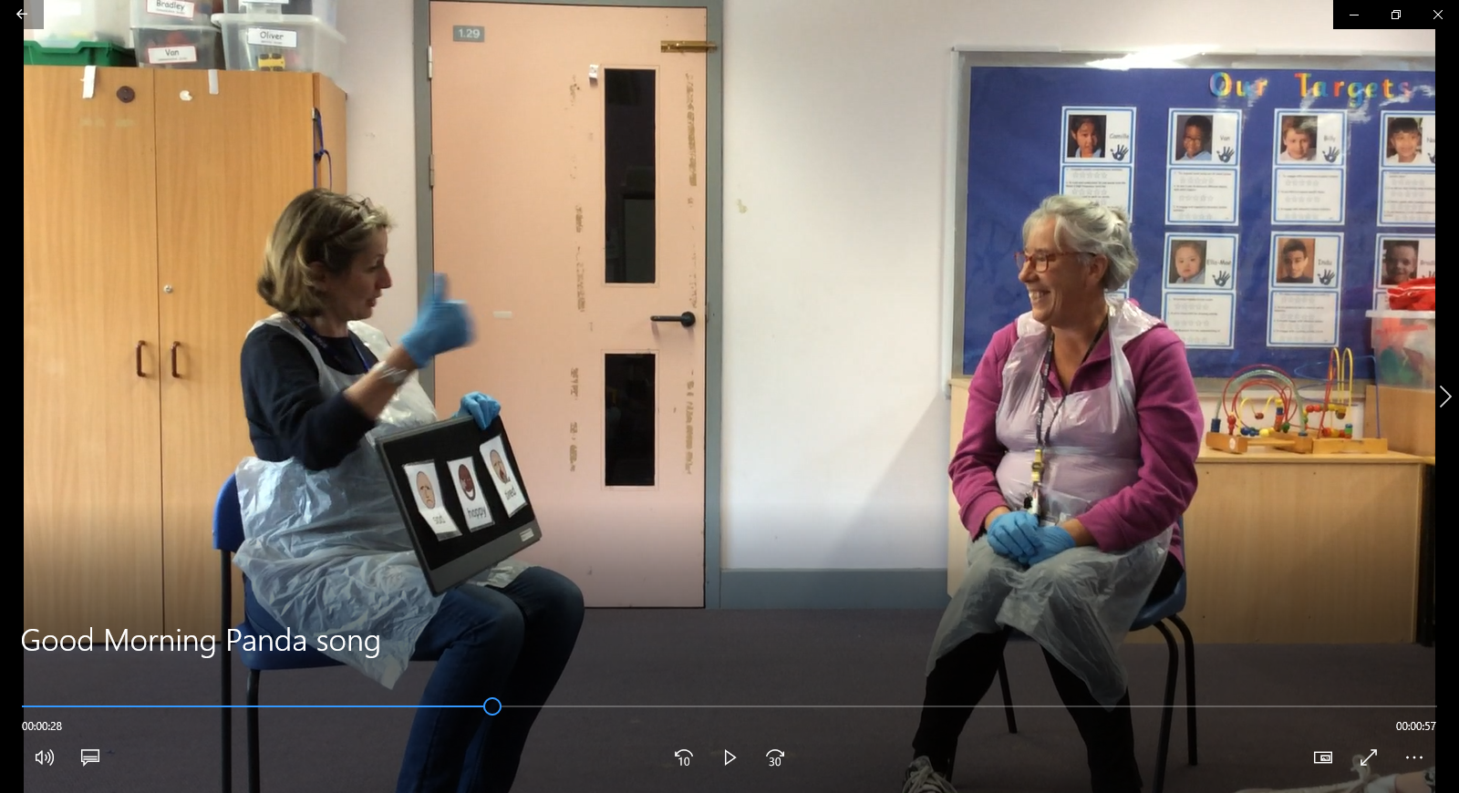
Panda pupils are supported to use symbols at school as a way to communicate their needs and emotions.
Often the first opportunity each day to use symbols is when we sing our
Good Morning song and we ask the children….
You might like to try this at home by watching the video of Panda’s Good Morning song and then printing out and offering the 2 symbols on the next page.
Each child will communicate in their own way. They may take a symbol, touch the symbol or they may very briefly look at the symbol they have chosen.

Slide 3
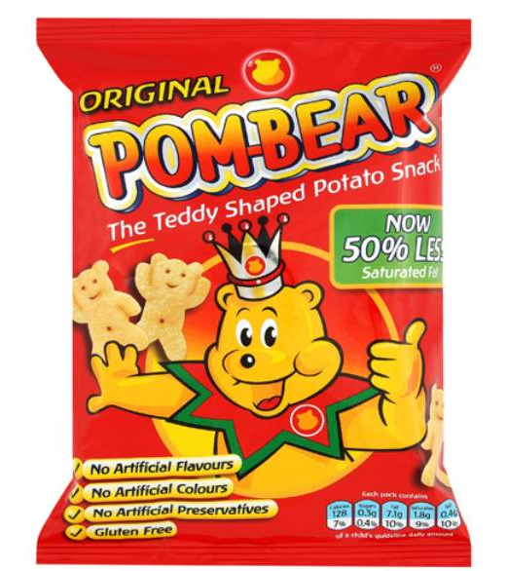
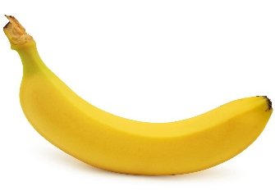
At snack time in class each child has their own personalised symbol board with a range of snacks that they like to eat and drink.
They look something like this one.
Some children will be happy with a generic picture of a food or drink while other children need to have a photo symbol of their own snack or water bottle to help them understand what they are asking for.
The symbols can be removed from the board so we can offer just one or two items to simplify the choice or remove one if it’s not available.
Children are encouraged to touch or hand over the symbol they are requesting and we confirm their choice by giving the requested item to them and saying….
‘You chose apple.’
Pom Bears
drink
banana

