Slide 1
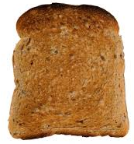
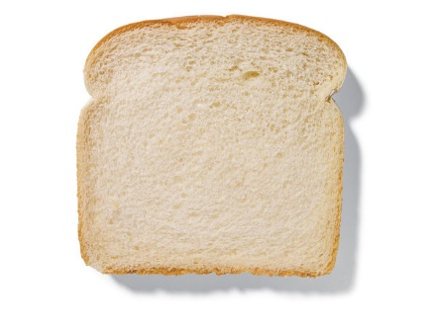
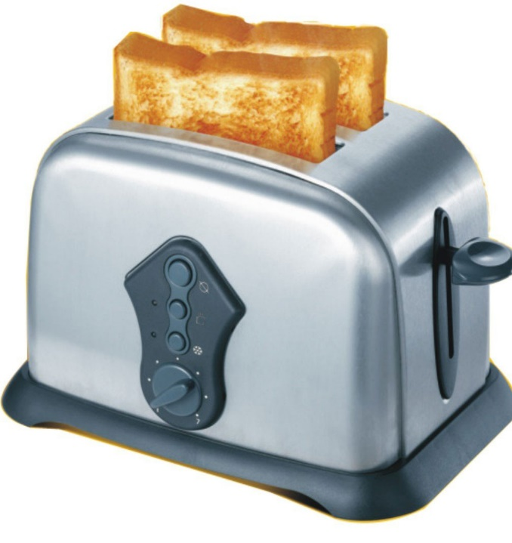
Toast experiment.
Panda Activity: Week 3
You will need to do this with your grown up as the toaster will get very hot.
June 15th 2020
Explore a slice of bread with your adult.
What does it feel, smell and taste like?
Now feel, smell and taste a slice of the toasted bread.
Is it different? How?
Which do you prefer?

Slide 2
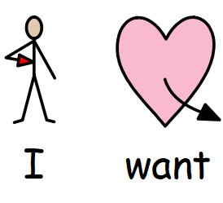
Symbols which may be helpful when making a sandwich or toast with your child.

Slide 3
Ask your adult to help cut out the pictures on this page
and then put into the right order on the next sheet.

Slide 4
Can you put the photo pictures in the correct order?
1
2
3

Slide 5
Match the symbols to the correct slice of bread?
For example where would you stick ‘soft’ ? Where would you put the symbol for ‘brown’?

