Slide 1
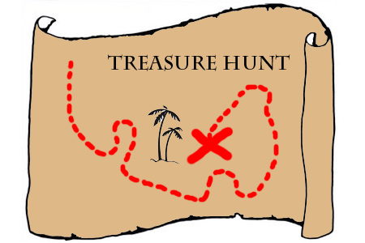
Reading Treasure Hunt
On #ReadingTogether Day celebrate reading in all its diversity!
Reading involves books and so much more.
Hunt for Reading Treasures (online and print) with members of your household and wider family.
FIRST:
Gather everyone together at home or online for around 20-30 mins.
Nominate someone to lead the Treasure Hunt (everyone else is hunting).
Guess what…adults will enjoy this too! ☺
THEN:
1. The Leader calls out the first Reading Treasure.
2. Everyone runs off to find their Treasure and returns to the group.
3. Points could be awarded for all who found Treasure and an extra point for the first one back.
4. Take turns to show what’s been found and perhaps chat about the choices and read an extract.
5. Move to the next Treasure and carry on…(you decide which and how many Treasures to find).
6. Have fun finding as many Treasures as you can! Did you realise how much there is to read at home?
Do take a photo of your Reading Treasure and share with friends and family.
#ReadingTogether
#ReadingTreasure
bit.ly/RfPHome

Slide 2
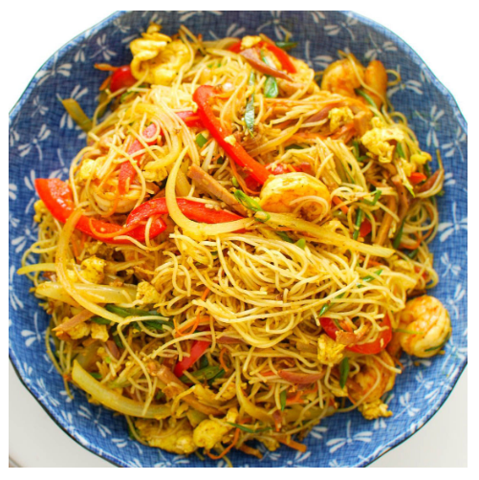
Comics/ Magazines
Reading that is hidden
Fiction books
1
9
16
Reading to organise things
Games
Reading to make you laugh
Songs and Rhymes
Cards/ Messages
Baby Shark
Baby shark, doo doo doo doo doo doo
Baby shark, doo doo doo doo doo doo
Baby shark, doo doo doo doo doo doo
Baby shark, doo doo doo doo doo doo
Baby shark!
5
2
8
12
11
Take away menus
Reading that gives advice
Food packaging
Reading that is precious to you
Catalogues/ Adverts
10
7
15
4
13
Non-fiction books
Recipes
News
An item with a slogan or logo
6
14
17
3

