Slide 1
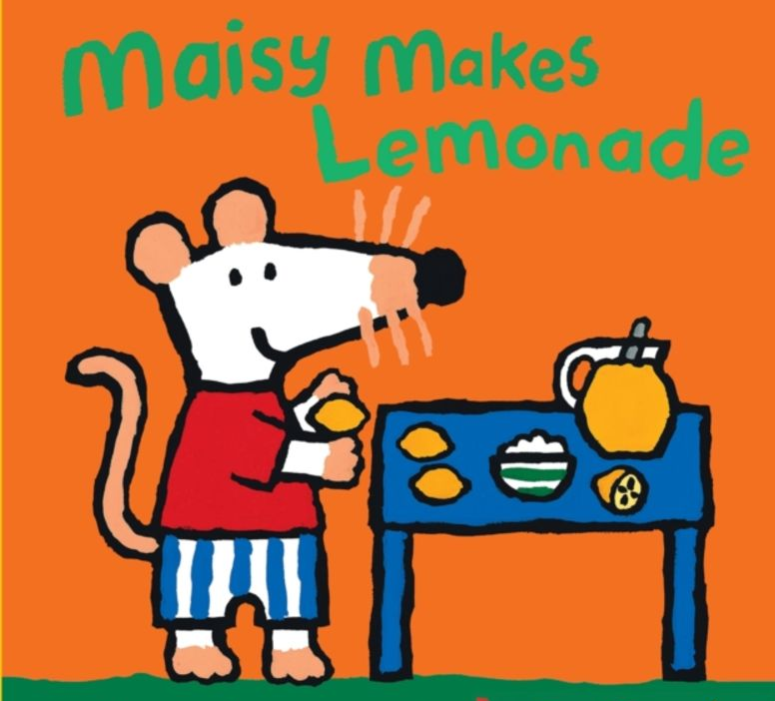
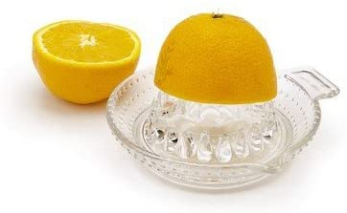
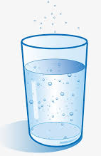
You can make your own lemonade
Watch Lauren
read the
Maisy Makes Lemonade
story on our Home Learning page.

Slide 2
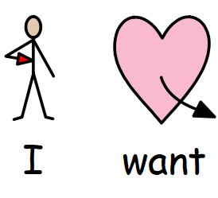
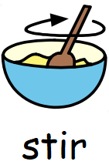
Symbols which may be helpful when making lemonade with your child.

