Slide 1
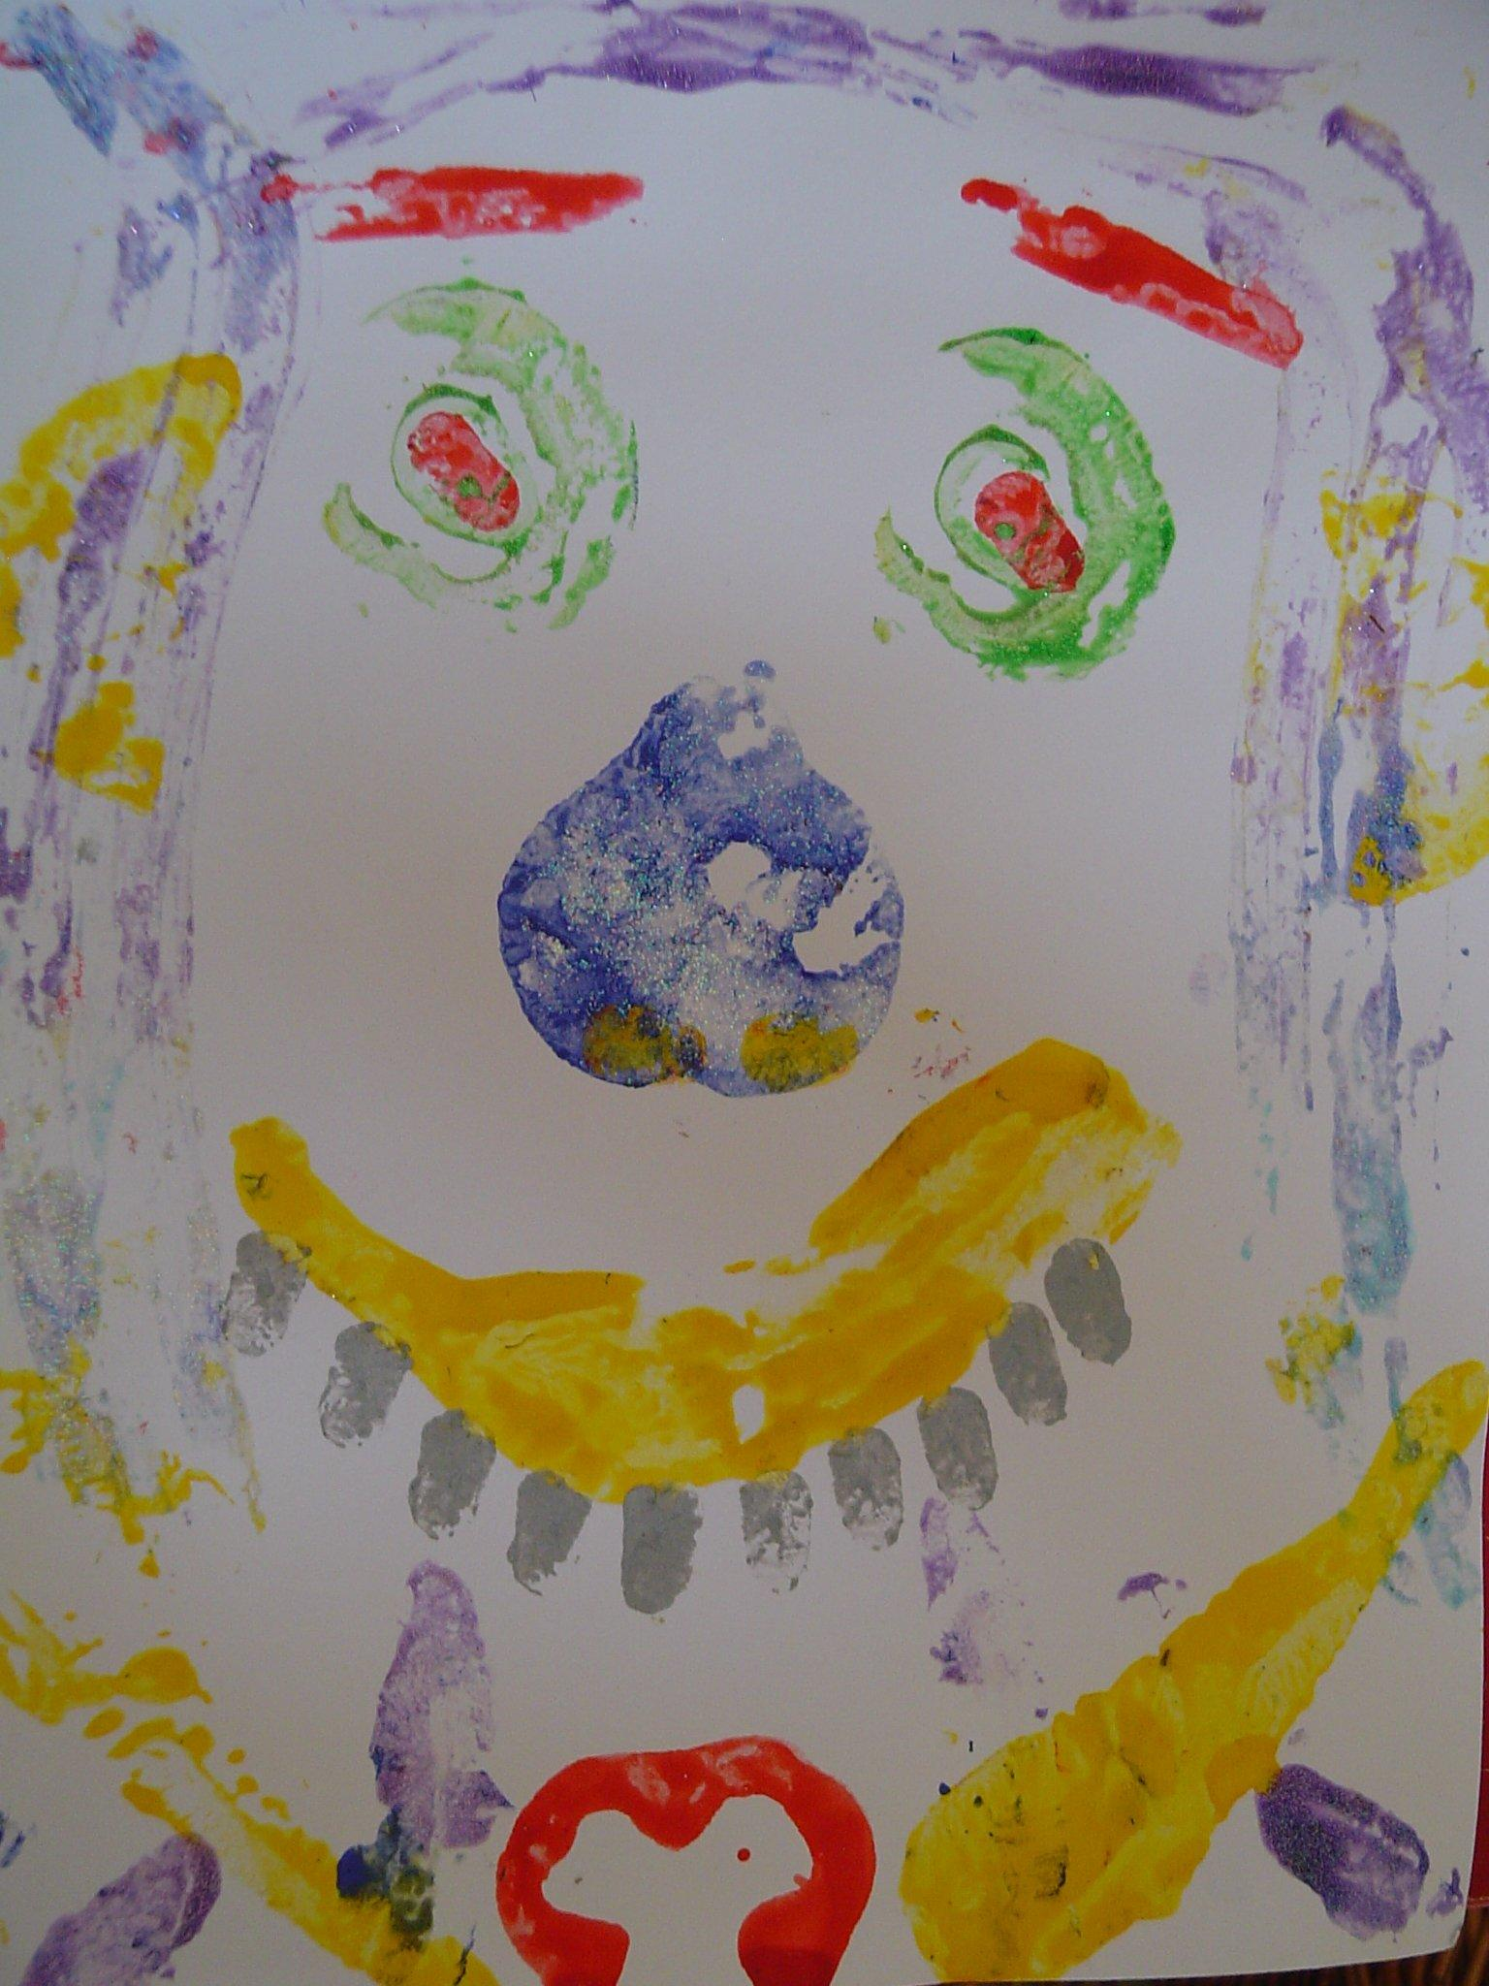
Vegetable Hunt
Use easy to find vegetables
Foe example:
Carrots
Tomatoes
Potatoes
Pepper
Place vegetables around you garden or around the house if more appropriate and go on a vegetable hunt with your child using the signs you have learnt.
When you have collected them sit down and taste the edible ones (NOT the POTATO)
You can then use your vegetables to print a vegetable face.
An example question:
Which vegetables would you use for the eyes?

