Slide 2
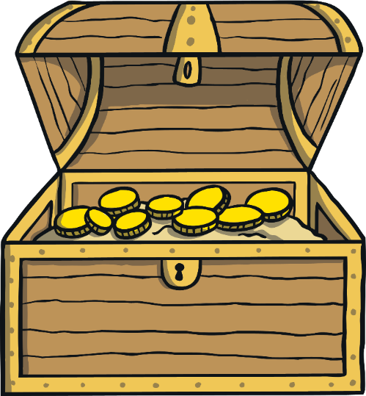
Remember to Practise Safely
Adapt: Make poses easier if your breathing isn’t smooth.
Breathe evenly: Take easy breaths in each pose.
Enjoy it: Move in a way that feels good. If it hurts at any point, stop.
Keep safe: Don’t touch others and use support where necessary.

Slide 3
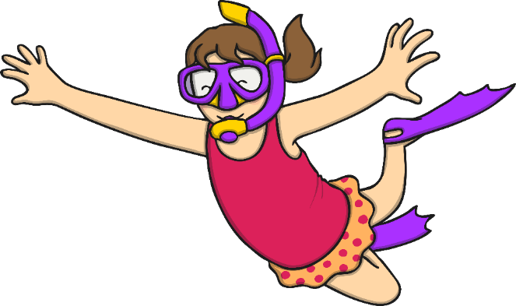
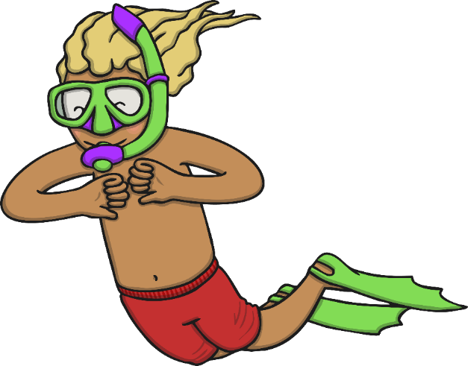
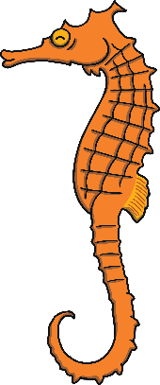
The pirates had been at sea for many months and they were getting rather bored. They decided to go swimming.

Slide 4
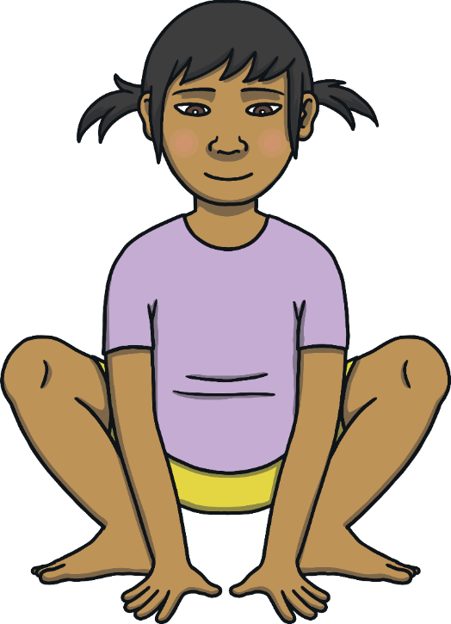
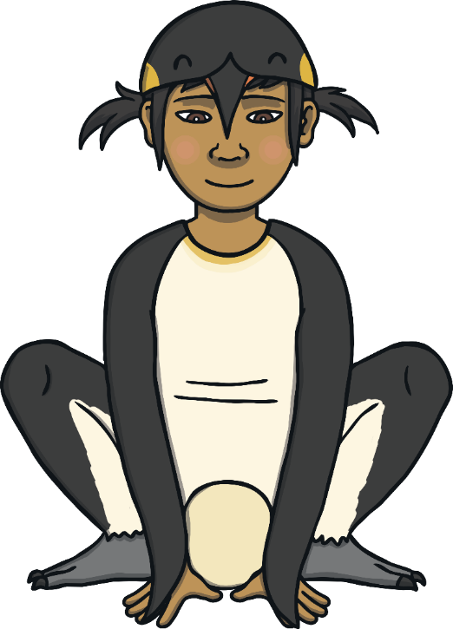
The penguins saw the pirates swimming and were very curious. They decided to join them.

Slide 5
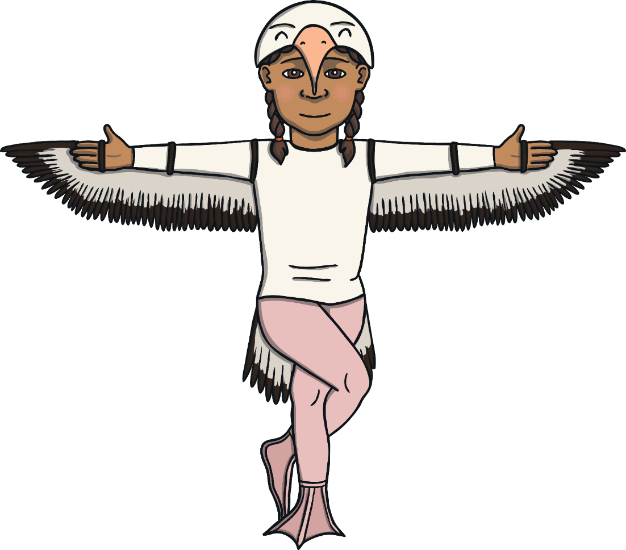
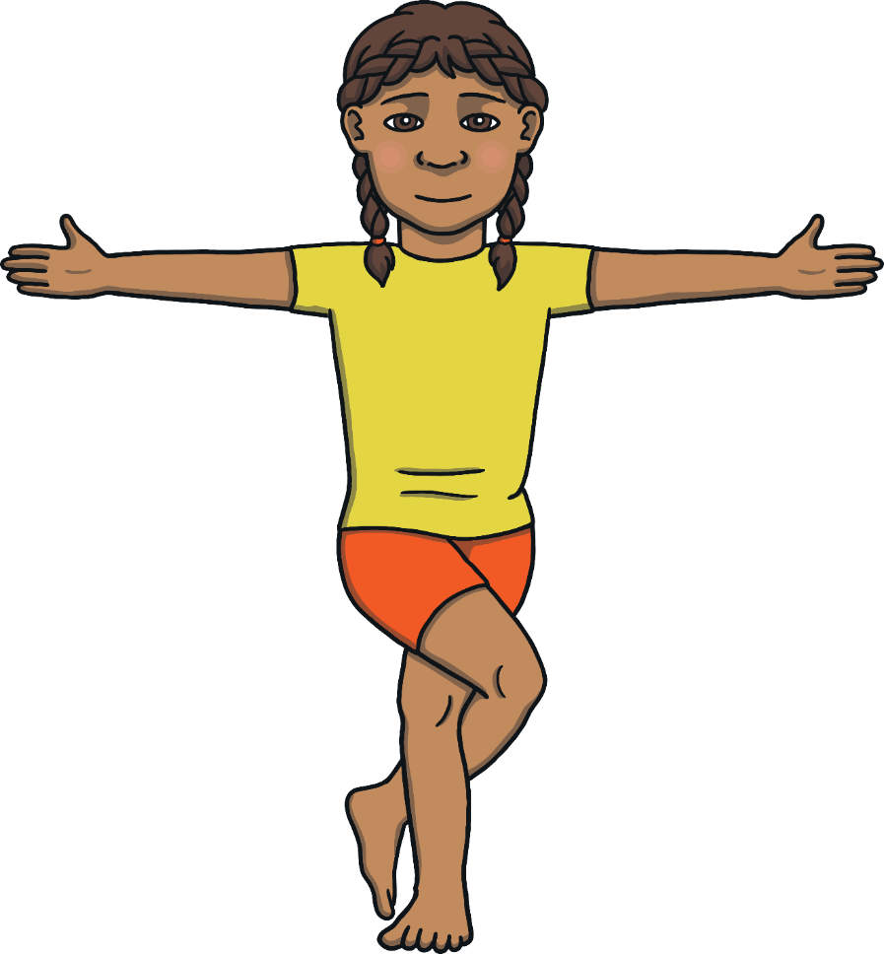
The albatrosses saw the pirates and the penguins having lots of fun. They decided it must be a parade and joined in by flying up above.

Slide 6
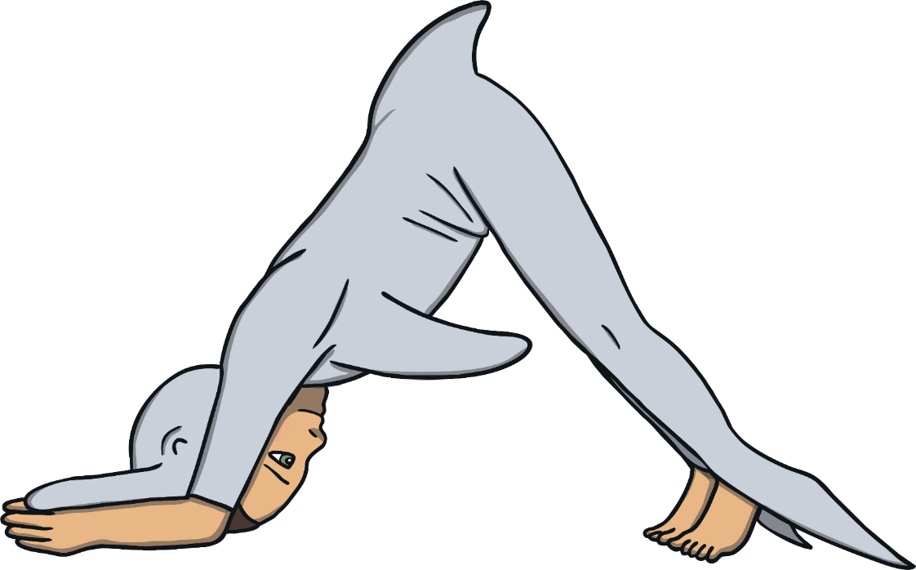
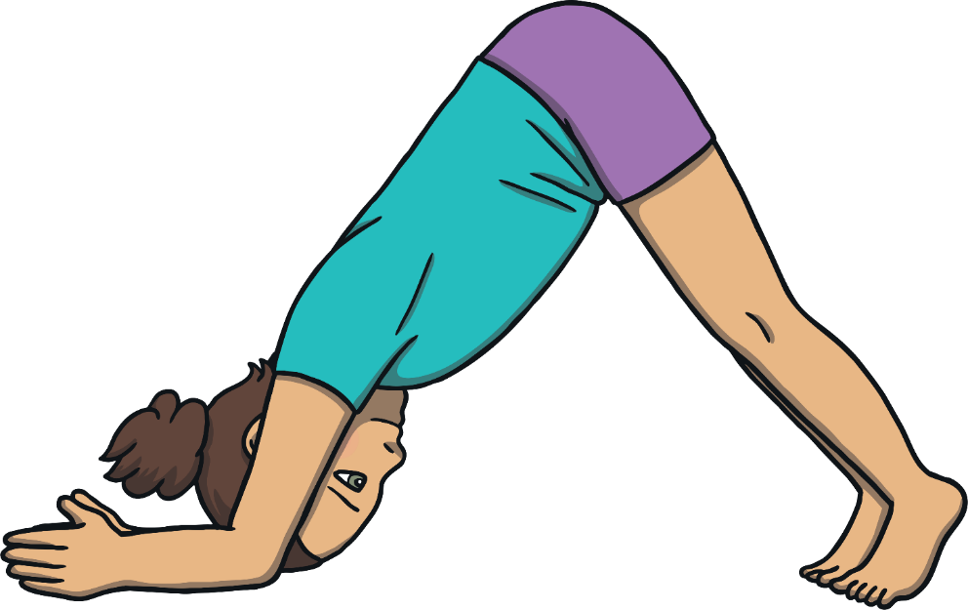
When the dolphins saw the parade, they jumped for joy and swam along after the others.

Slide 7
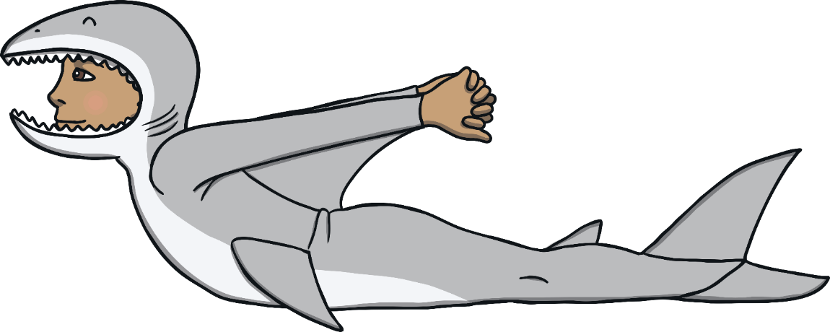
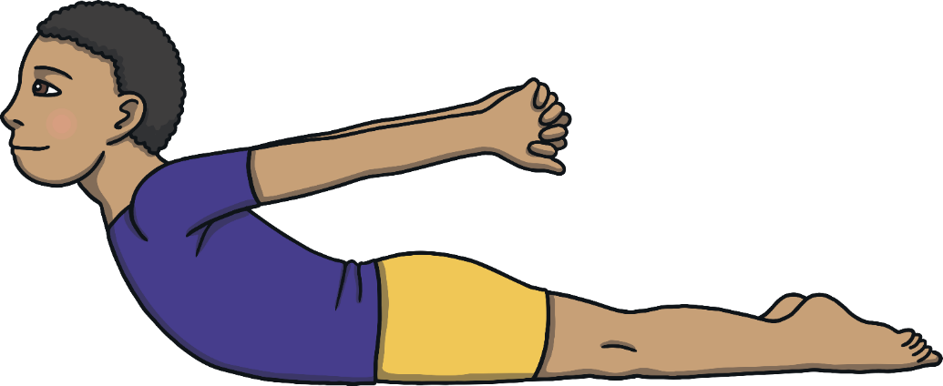
The sharks saw the dolphins jumping through the waves and decided to lurk behind them. Maybe they were getting hungry...

Slide 8
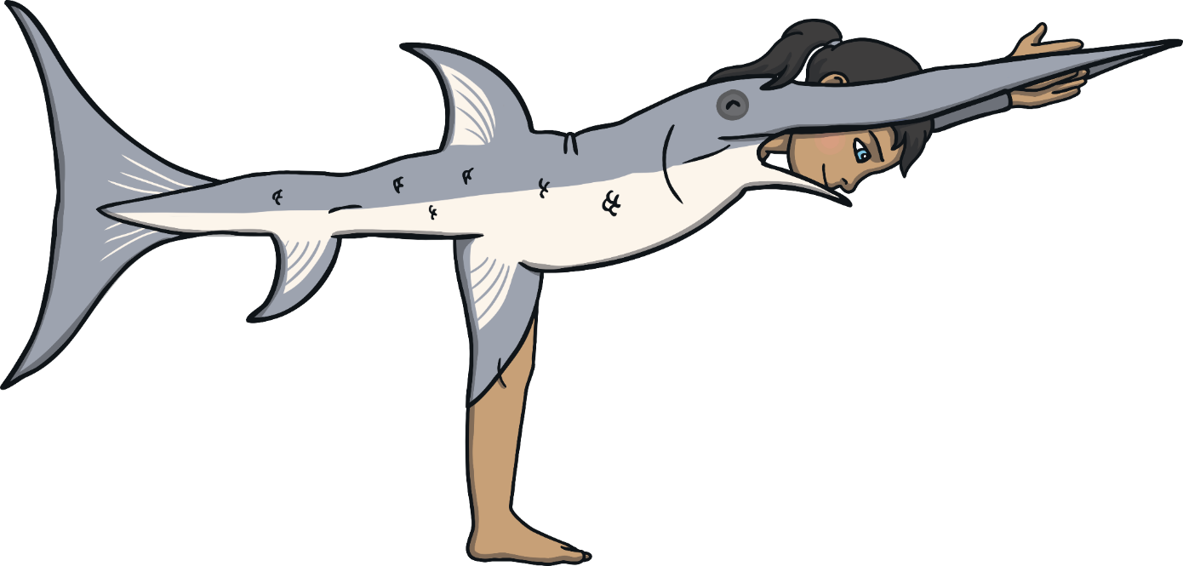
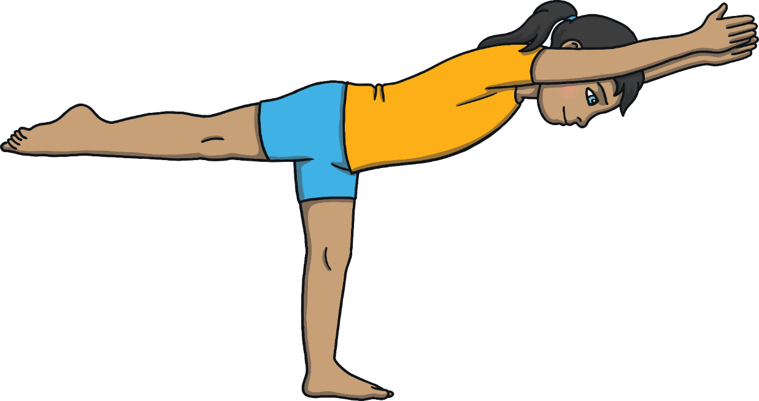
The swordfish saw the sharks and tagged along. They tickled the sharks with their pointy noses and made them giggle. This made the sharks forget all about their hungry tummies! They decided to join in with the fun and games instead.

Slide 9
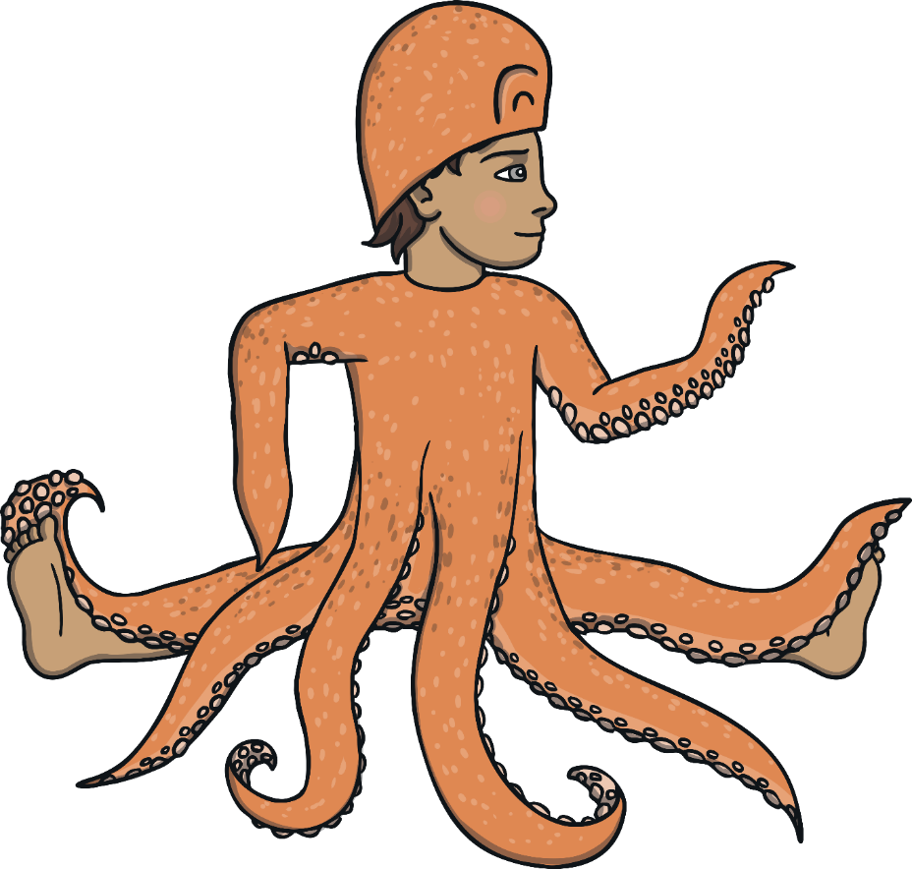
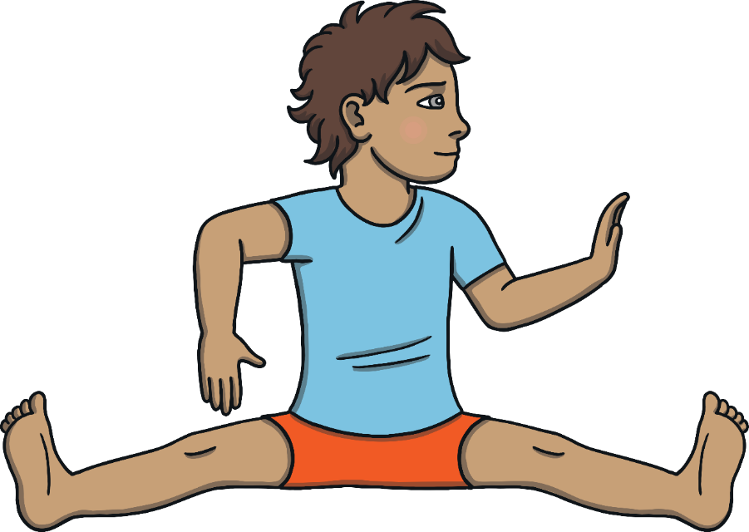
An octopus saw the curious parade and followed to see what was going on. He decided he would like to be a part of it too! When any of the younger animals got tired, he carried them in one of his
eight arms.

Slide 10
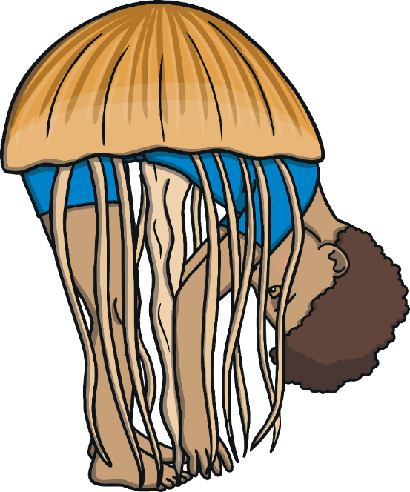
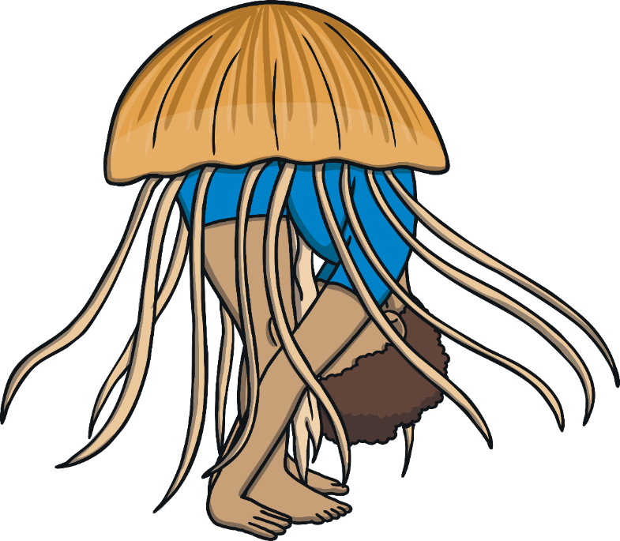
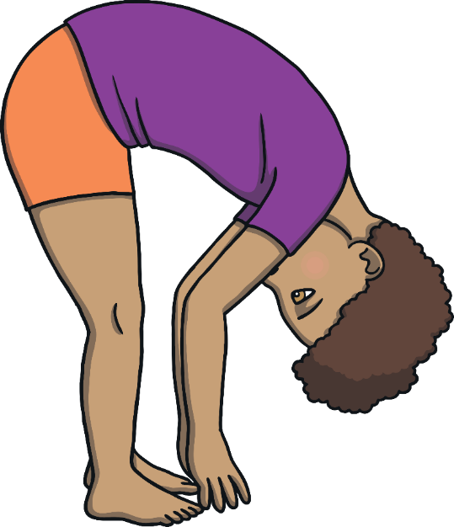
A swarm of jellyfish saw that the octopus had his arms full so they came to help. The jellyfish invited the other tired, little animals to rest on top of them as they floated along.

Slide 11



16 tiny seahorses saw how kind the octopus and the jellyfish were being so they came to play music for the parade.

Slide 12

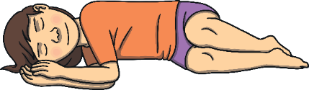
The magical noise made everyone fall asleep.

Slide 13
The parade travelled through the ocean until everyone was very tired.

Slide 14
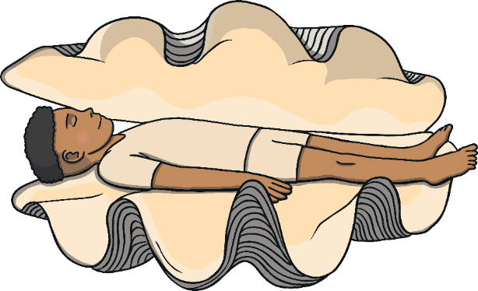
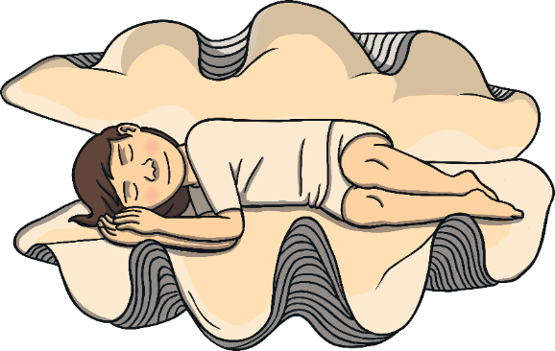
The pirates and the parade of animals felt exhausted. They were very happy to rest after all the excitement and they floated peacefully together in the ocean.

Slide 15
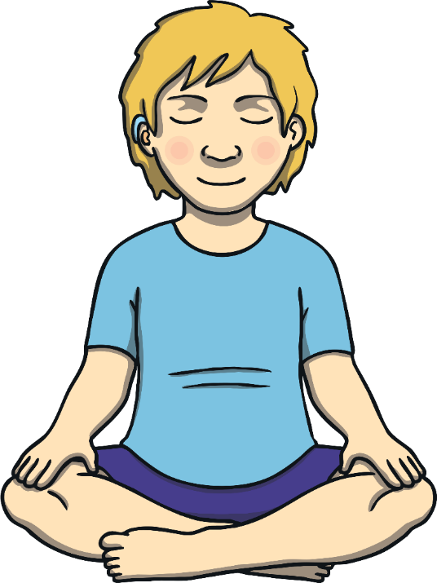
Every member of the parade felt very lucky to have had such a special and happy time together. They all took a moment of quiet and calm to enjoy this feeling.

Slide 16





Timer Finished
Start Timer

Slide 17

Namaste

