Slide 1
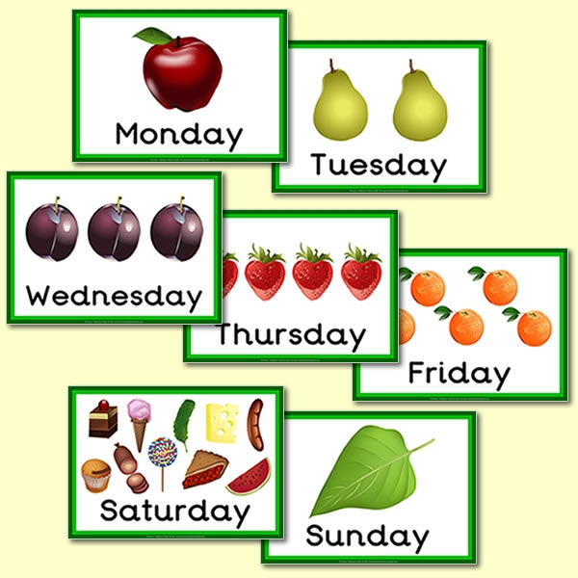
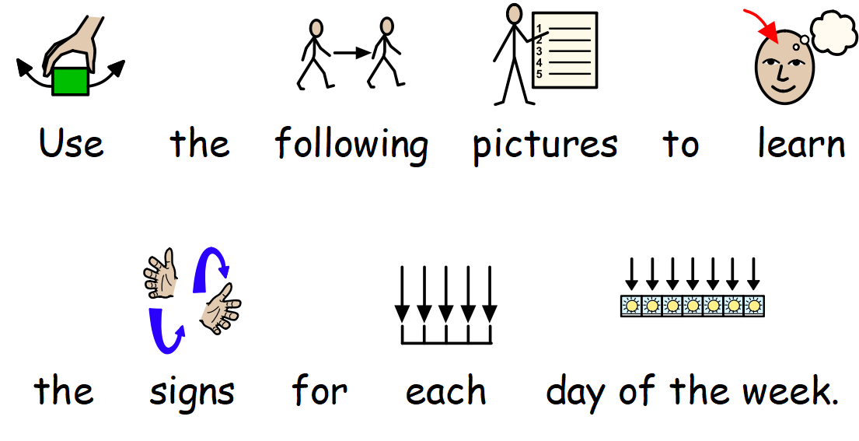
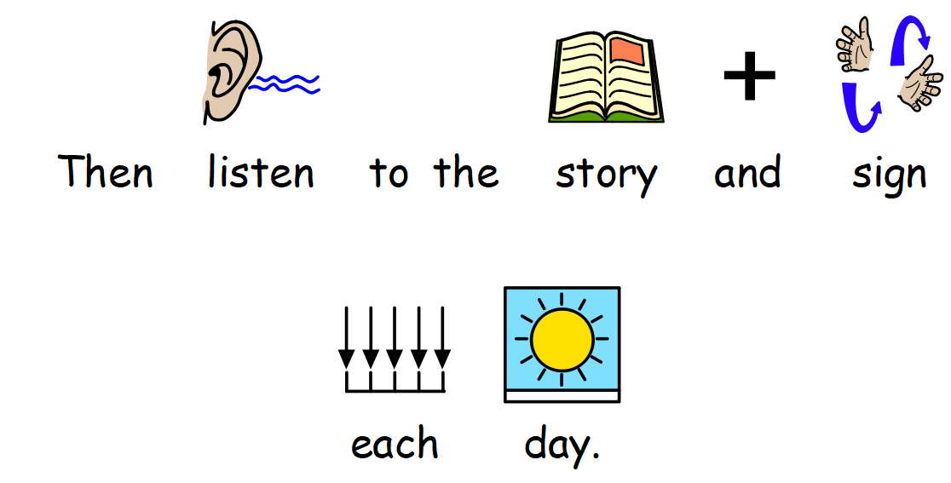


Slide 2



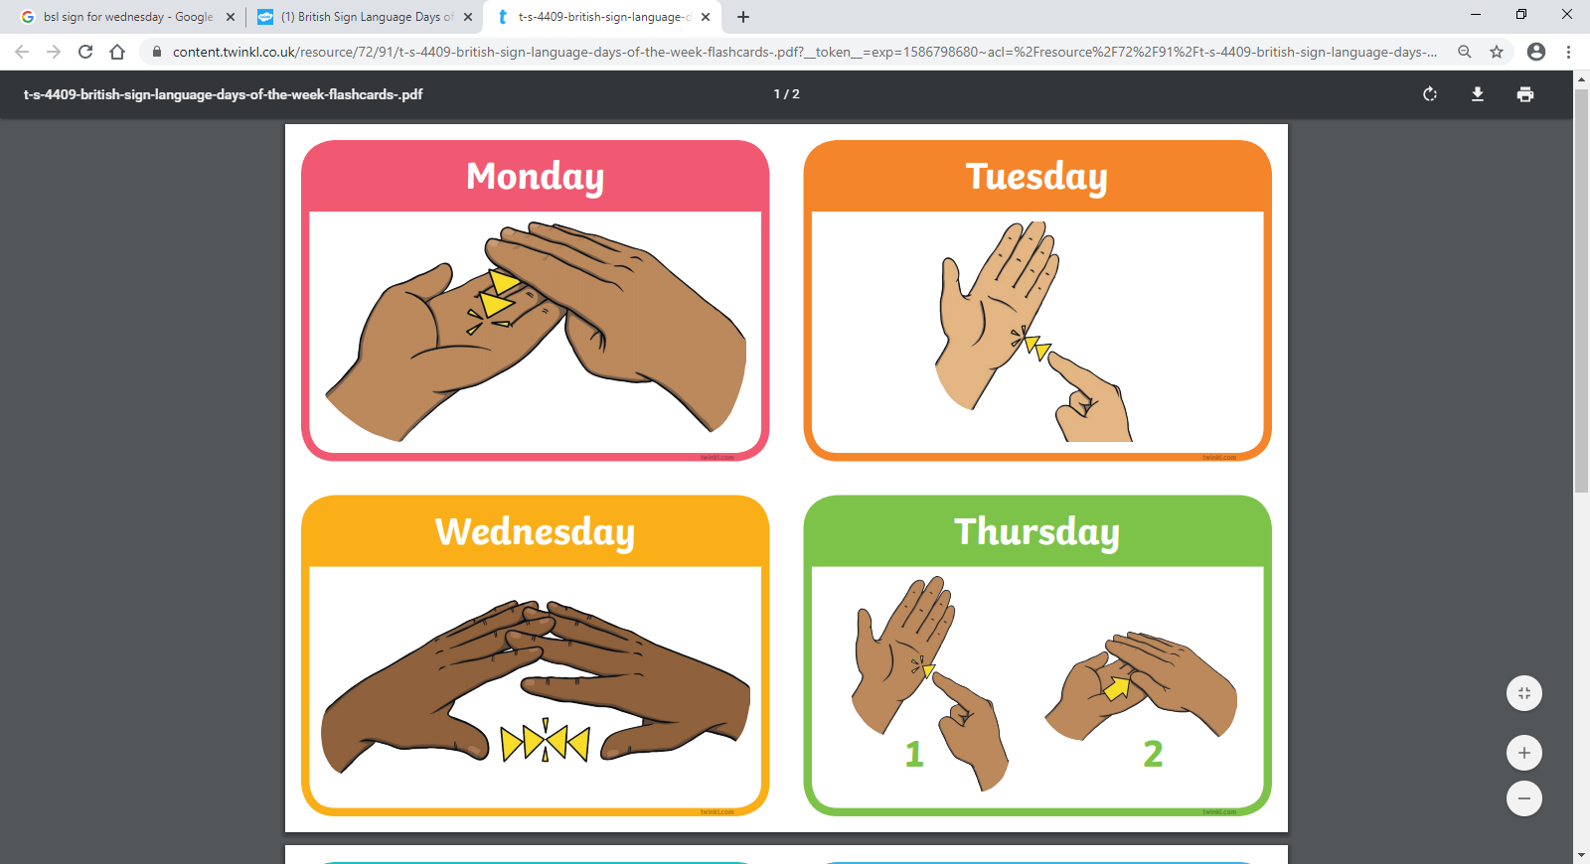

How to sign the days of the week.
Tap 3 fingers onto palm twice.
Tap index finger to side of palm twice.
Thread fingers together twice.

Slide 3




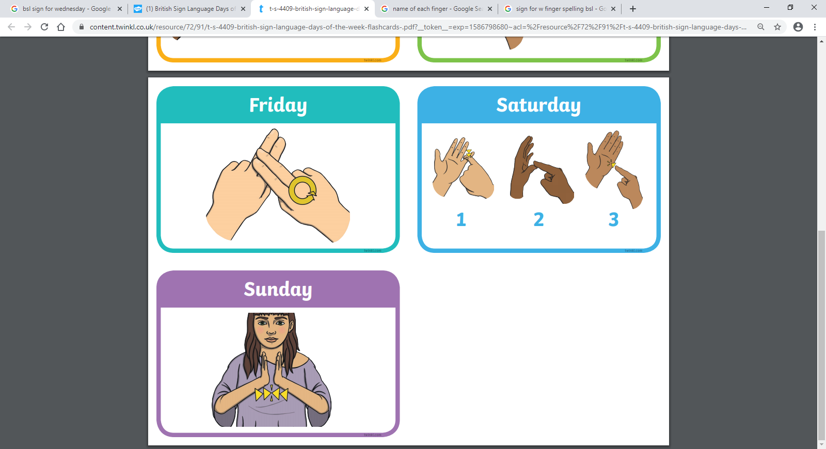
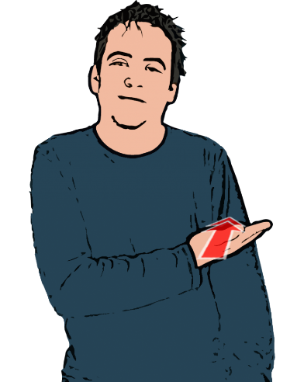
Tap index finger to side of palm then slide your hand across flat palm.
Place 2 fingers over 2 fingers and circle twice.
Open hand taps upper arm twice.
Open hands tap each other palm to palm twice.

