Slide 1
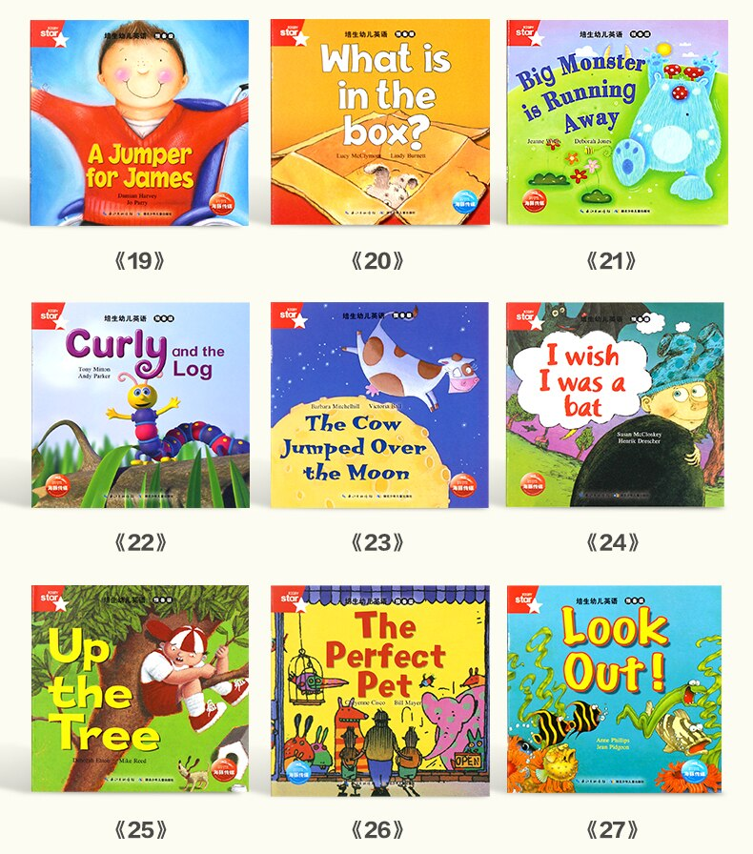
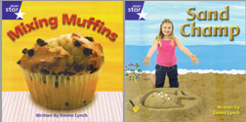
A guide to reading with
your child at home
1. Modelled Reading : I read and You listen
The aim is to have a relaxed time and enjoy looking at a book or sharing a story together.
As you read you will be demonstrating a love of books and early reading skills. Be led by the actions and interests of your child. Make use of puppets, a favourite toy, books with songs, rhymes and textures.
Your child will be developing their listening skills and extending their vocabulary as they listen.
3. Decoding Reading : You read and I help
Your child might be able to de-code some words such as c-a-t, m-u-m, d-a-d . Help them to find these words in the sentence and attempt others.
Some children may also recognise and read words without sounding them out but by recognising their shape or pattern. These are called Whole or Sight words.
Encourage your child to hear the rhyme and rhythm in words with books such as Oi Frog – Kes Gray or A Squash & a Squeeze – Juila Donaldson.
2. First Steps reading : I read and You help
Encourage your child to join in with the story-telling. Maybe by using a character toy or puppet.
Can they find the front of the book?
‘What might this story be about?’ Help your child to use the pictures to say what is happening on each page.
Together point to characters or picture detail. ‘Where is the dog hiding?’
Support them to join in with repetitive parts of the text? ‘We’re going on a bear hunt…We’re going to catch a ….?
Talk about what you are reading. Encourage prediction…’What do think is going to happen next?’
4. Independent Reading : You read and I listen
Support your child to build and extend the number of High Frequency Words they can read. These are common words that appear very often
in writing. Your teacher will be able to give you a list.
Encourage your child to read and listen to a broad range of books and stories in whatever way they enjoy most.
Support them also to use their growing skills wherever you are.
What signs can they see? What does that say?
This is a general guide. Each child will have their own individual way of accessing books and reading. Your child’s class teacher will be very happy to give you more specific help and ideas so please ask via your Home School diary or at your next meeting.

Slide 2
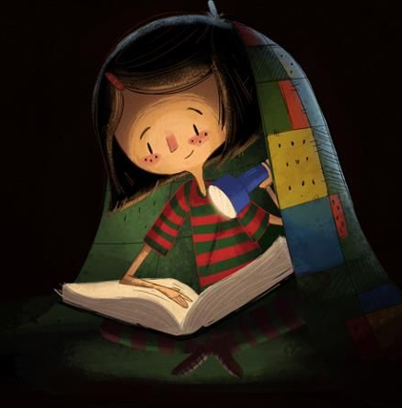
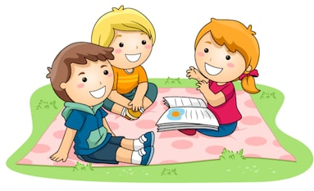

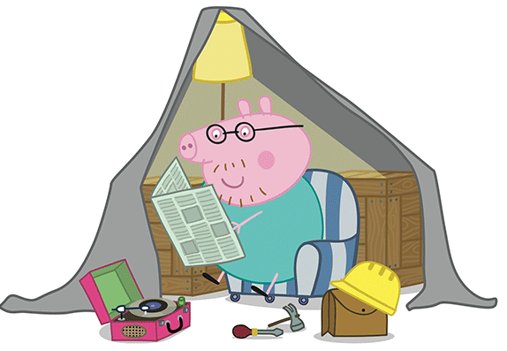
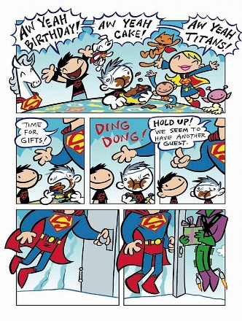

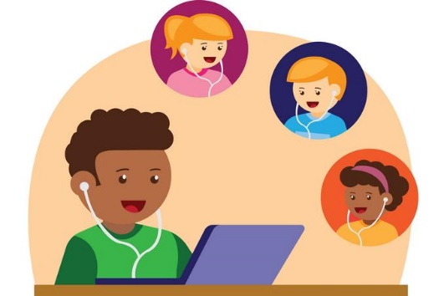
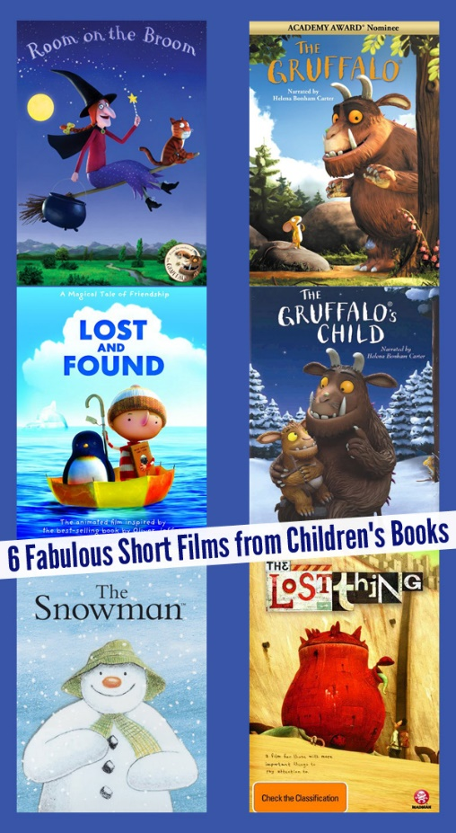

Fun Reading Challenges for Home.
Share a book in the garden.
Take your toys and have a picnic.
Read under the covers with a torch.
Swap roles and read a bedtime story to your parents. What’s their favourite book?
Read to your baby brother or sister or your pet!
Read a book that that was written the year you were born! Ask your parents and grandparents what their favourite book was when they were little.
Make a den or put up a tent to read in. You may need a snack in there too!.
Share a book about your favourite TV character such as Peppa Pig, Fireman Sam or Paw Patrol then watch an episode together.
Read a comic.
Read an e-book.
Most libraries will let you borrow
an e-book or check out Oxford Owl.
Zoom your Grandparents or a friend and read to each other. Don’t’ forget to show them the pictures!
Can you find a book that’s
been made into a film or a
TV program?
Share a book with no words.
Can you make up a story to go with the pictures?

Slide 3



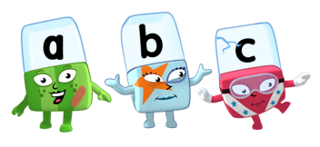
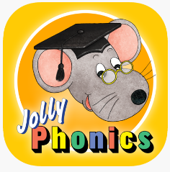
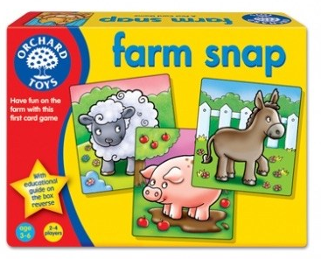






Ways to support your child’s reading at home
Your child might bring a book home to share from school. If not then share books and stories together that you know your child really enjoys so it is a treat for them.
Try to find a quiet and relaxed time to share a story each day.
It doesn't matter how old your child is, if they enjoy listening and reading then you can do this together, either reading instalments of a story or listening to an audio book together over time.
Listen to stories on Cbeebies, CBBC radio or Audio Apps. Listen in the car!
Watch Cbeebies Alphablock’s episodes. You could try and teach each other the visual phonic sign for the letters- see our video of this on the school website or just have fun watching the cartoon!
The Jolly Phonics App and books are another way for your child to have fun while hearing the phonic sounds of each letter.
Play matching games such as Snap! or Pairs. You can play with picture cards or you can make your own with pictures and words that are particularly motivating for your child.
Point out words and logos as you unpack shopping. Let your child see you reading the labels or logos.
Have fun trying to spot and ‘read’ signs when you are out and about such as road signs, the M for McDonalds or bus numbers.
Websites such as BookTrust and Oxford Owl have free e-books, helpful information and tips on both phonics and reading. Your child’s class teacher will be very happy to give you more specific help and ideas so please ask via your Home School diary.

Slide 4
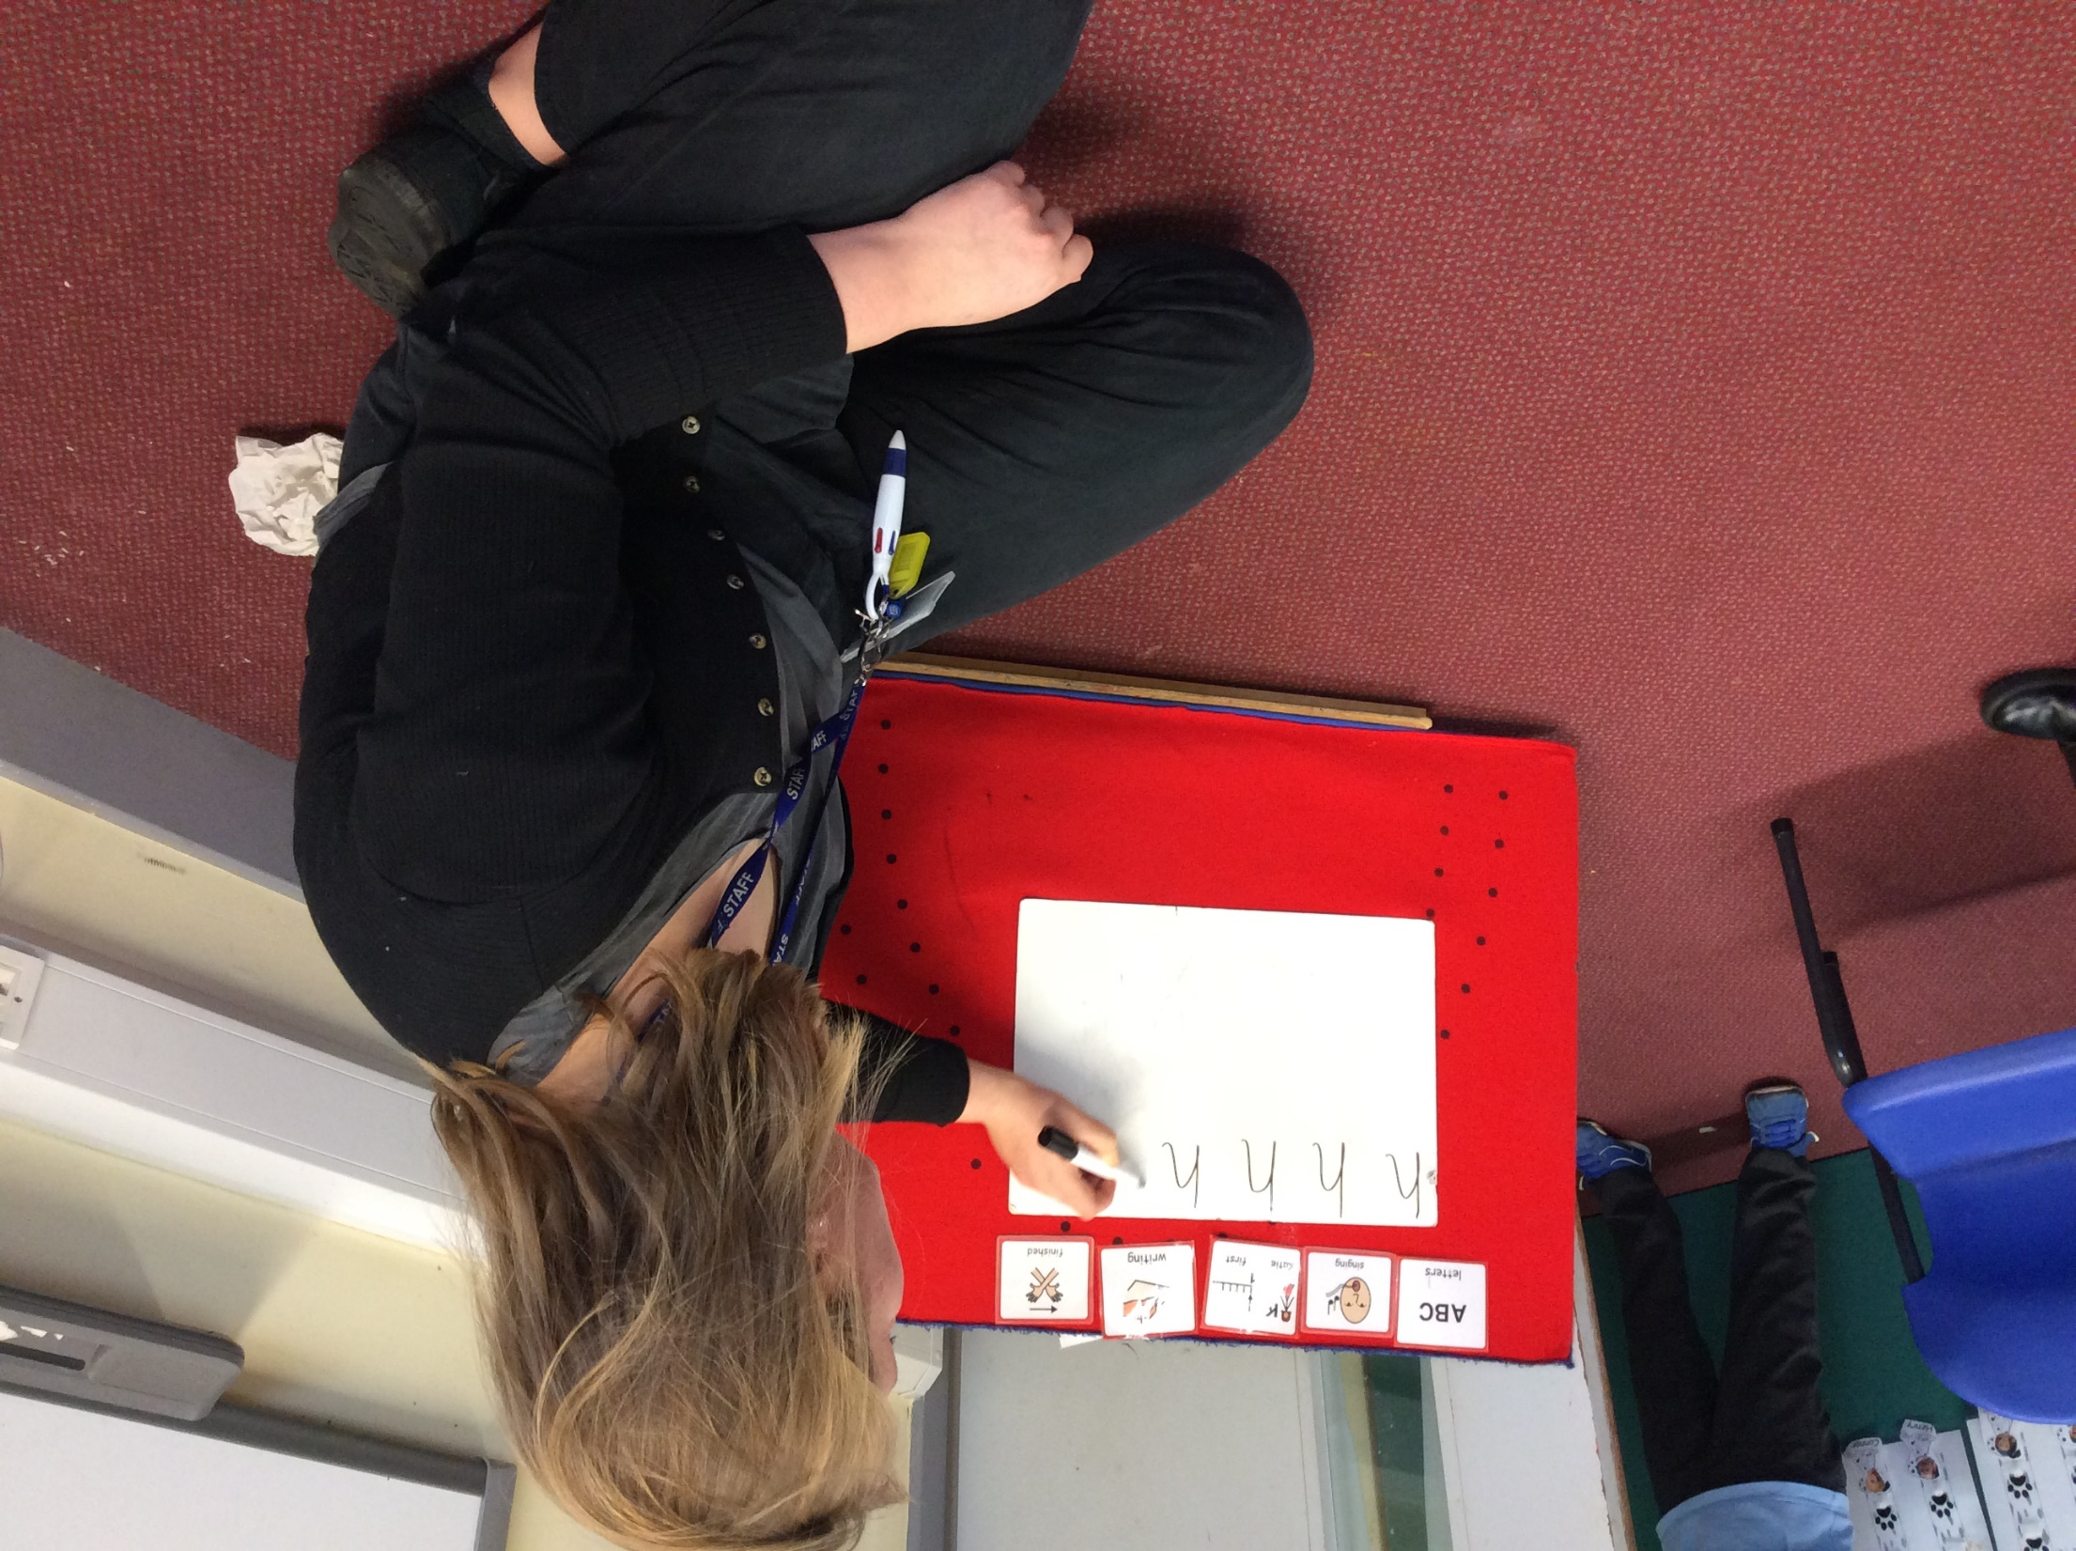
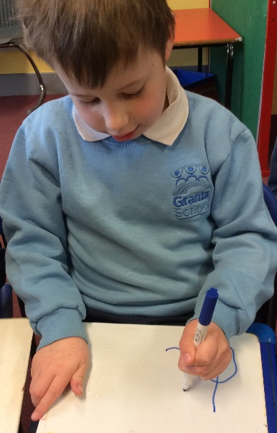
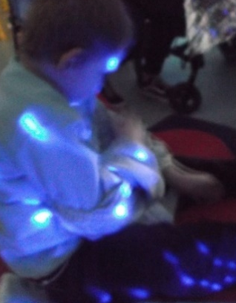
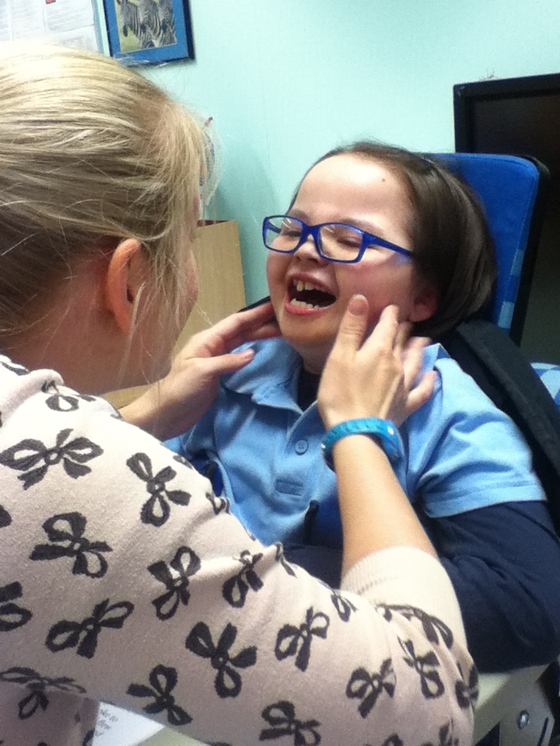
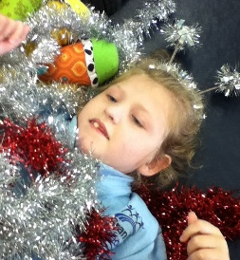
How we teach Reading at Granta
These are some of the many ways we foster a love of reading across our school.
Listening to and taking part in songs, rhymes and stories everyday.
Sensory stories – These are designed as a way to experience stories using all our five senses alongside creative use of story props.
Attention Autism stories – This way of telling a story helps children to develop their attention skills by engaging with a short sequence of gripping and exciting events.
Phonics – At Granta we use an approach called Letters and Sounds. We follow the order of the letters but allow each child as long as they need to secure their learning before moving on.
Initially your child will play lots of fun sound games that encourage and develop speaking and listening skills. This is called Phase 1.
Further Phases involve learning the sound for each letter of the alphabet and blended these together to make words such as c-a-t.
There are 6 phases which progress towards fluent independent reading.
The first letter sounds your child will be taught are s a t p i n.
Your child may naturally start hearing other letter sounds that are familiar and meaningful to them such as mmmmm-mum or the initial letter sound for their name. Please watch our Visual Phonics Signing video which shows the signs for each letter sound and name.

Slide 5
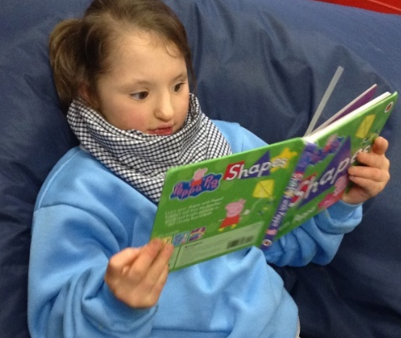
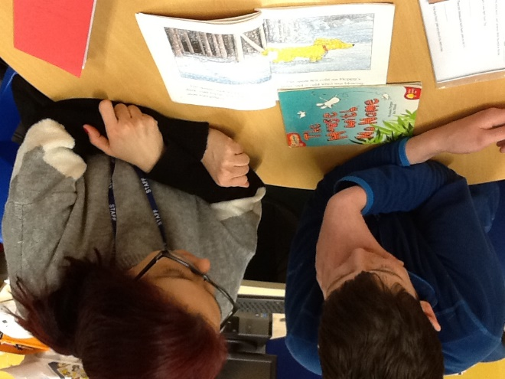
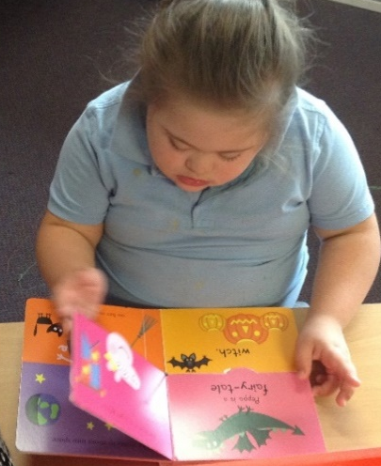
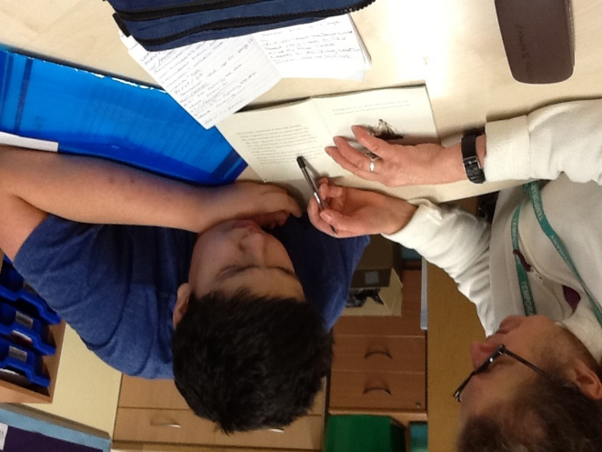
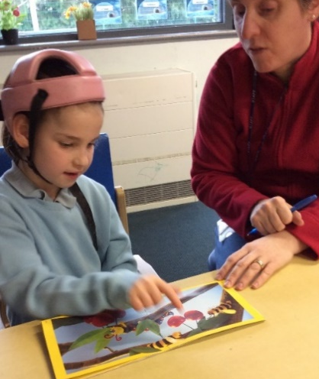
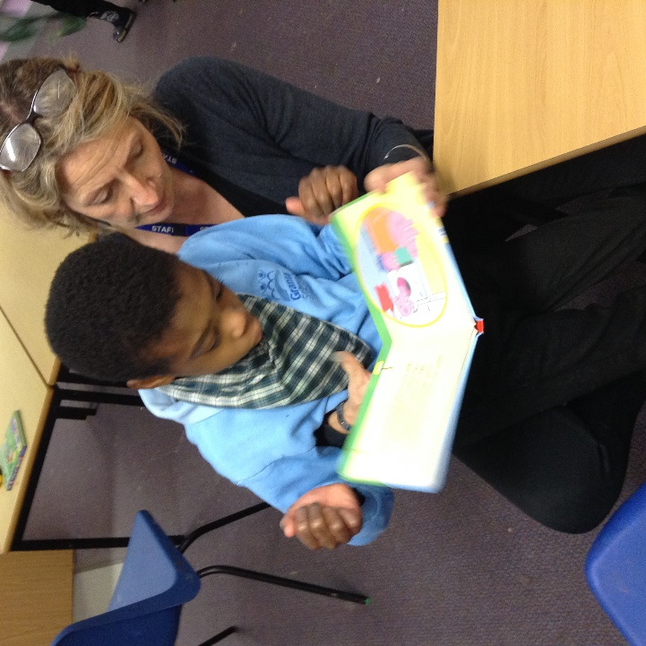
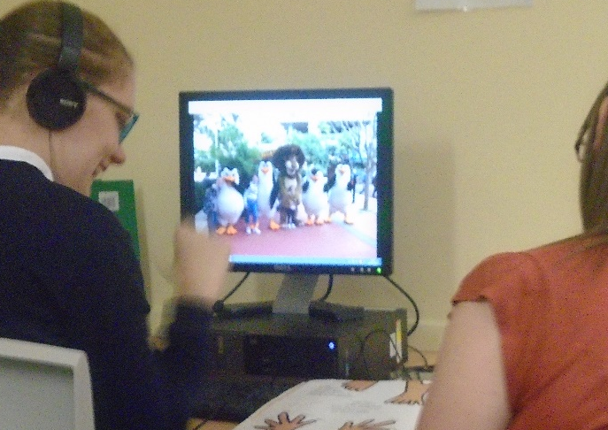
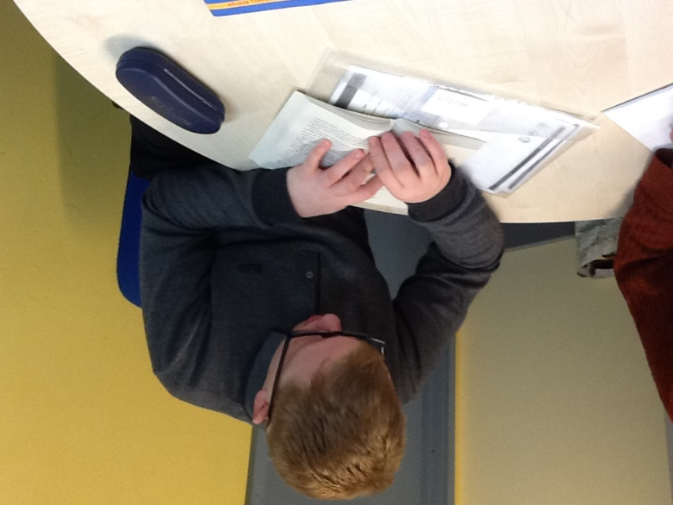
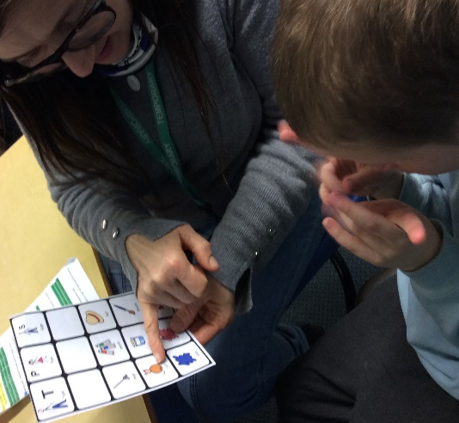
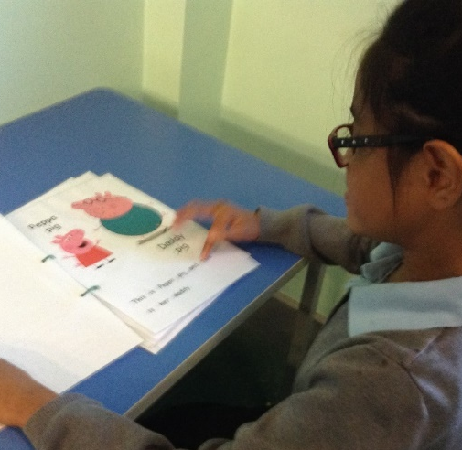
Individual Reading - This is when your child shares a book one to one with an adult. For some pupils this will be a favourite picture book from our library, for others this will be a book from a reading scheme.
A reading scheme is a structured and levelled set of books written specifically to ensure that your child builds on their reading knowledge in steady and progressive steps.
We use more than one scheme at Granta so there are a broad range of books to read at every level. The levels are colour coded starting with Lilac for books with only pictures, progressing next to Pink, then Red and eventually through to Lime which resembles a slim novel and has chapters.

Slide 6
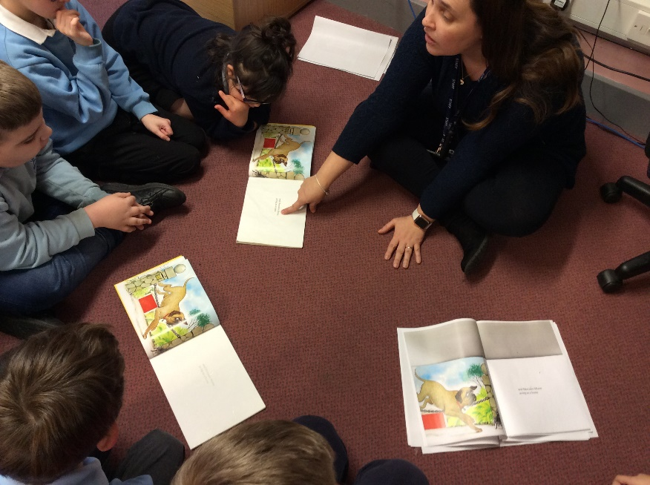
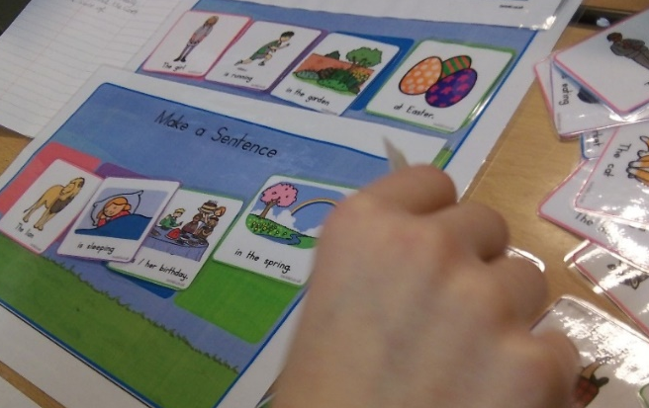
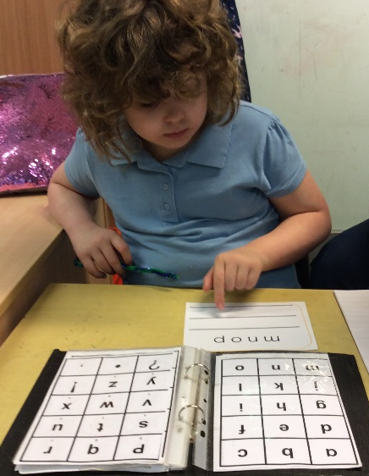
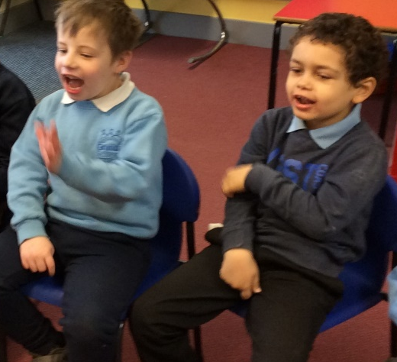
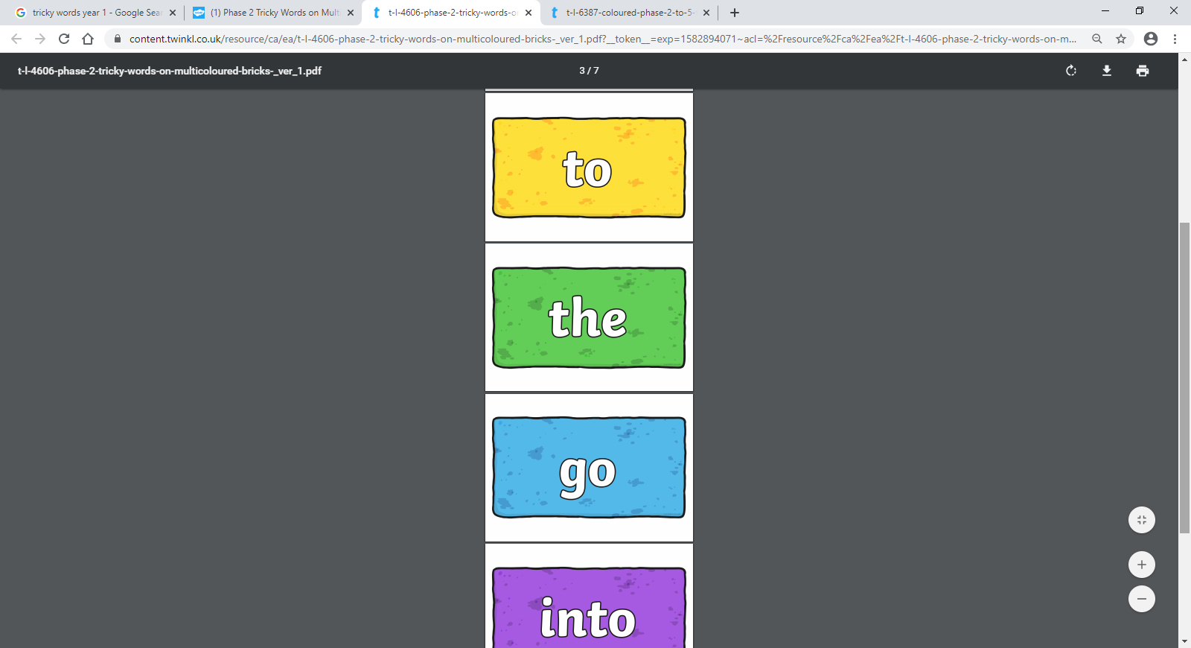
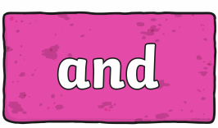
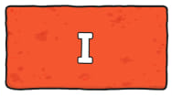
Using symbols in everyday communication so that pupils understand that symbols and print have meaning.
Whole or Sight words are words that your child might read without sounding them out but by recognising their shape or pattern. These might be words that are important to them such as their name.
Sight word reading is used alongside Phonics especially with tricky words such as ‘the, to, you’ which can’t be de-coded by blending the individual sounds together.
Guided Reading is when a small group of children read the same book. This gives an opportunity for pupils of a similar level to develop their confidence when reading aloud and to learn skills and reading strategies from each other.
BSL signing- Your child will learn to sign the sound of each letter. This is called visual phonic signing. With the help of Steph Woodley , a teacher here at Granta, we have made a simple video that shows the BSL signs for each letter’s name and sound.

