Slide 2
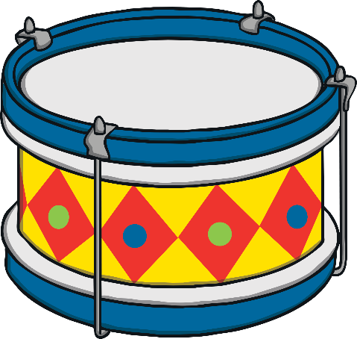
When I was one I banged my drum the day I went to sea,
I jumped aboard the pirate ship and the captain said to me,
We’re going this way, that way,
Forwards, backwards over the Irish Sea,
A bottle of rum to warm my tum and that’s the life for me.

Slide 3
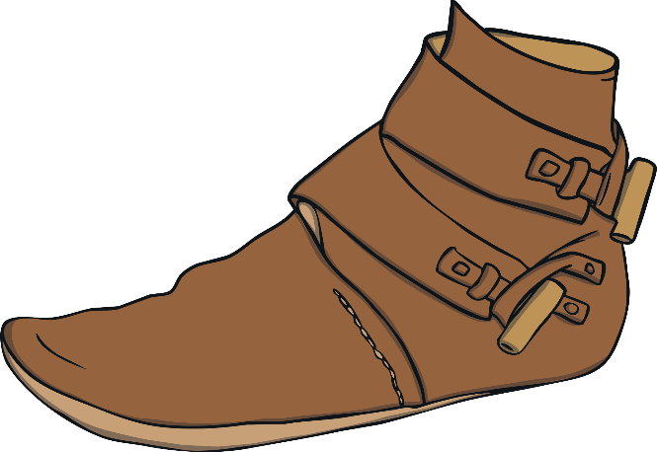
When I was two I lost my shoe the day I went to sea,
I jumped aboard the pirate ship and the captain said to me,
We’re going this way, that way,
Forwards, backwards over the Irish Sea,
A bottle of rum to warm my tum and that’s the life for me.

Slide 4
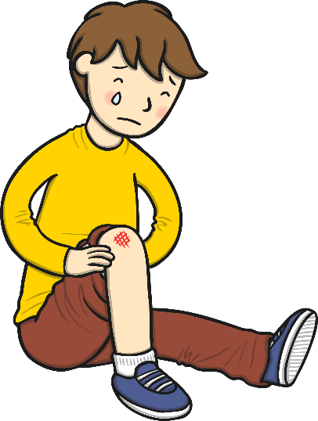
When I was three I banged my knee the day I went to sea,
I jumped aboard the pirate ship and the captain said to me,
We’re going this way, that way,
Forwards, backwards over the Irish Sea,
A bottle of rum to warm my tum and that’s the life for me.

Slide 5
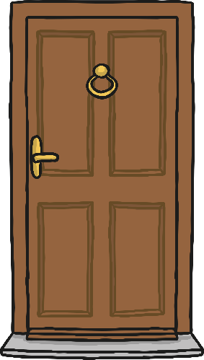
When I was four I knocked the door the day I went to sea,
I jumped aboard the pirate ship and the captain said to me,
We’re going this way, that way,
Forwards, backwards over the Irish Sea,
A bottle of rum to warm my tum and that’s the life for me.

Slide 6
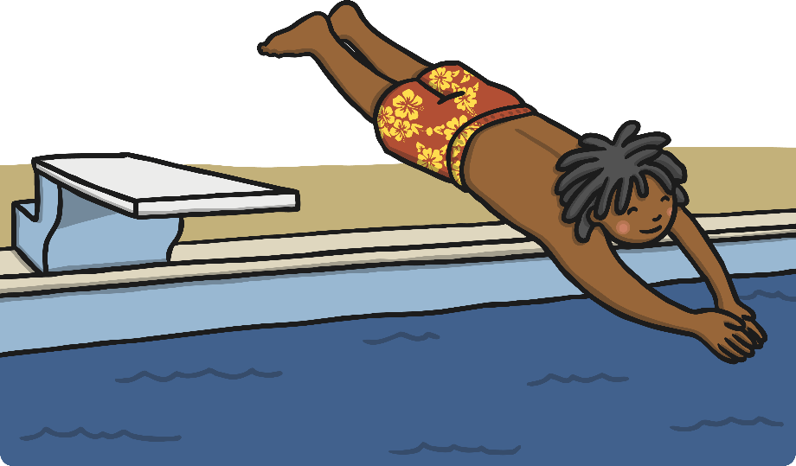
When I was five I learned to dive the day I went to sea,
I jumped aboard the pirate ship and the captain said to me,
We’re going this way, that way,
Forwards, backwards over the Irish Sea,
A bottle of rum to warm my tum and that’s the life for me.

