Slide 1
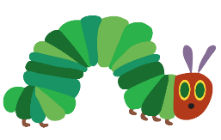
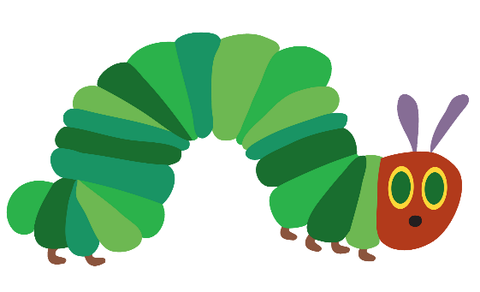
Find this episode of Cosmic Kids on YouTube.
The moves are all based on
The Very Hungry Caterpillar story.
Most of the movements are very gentle but you will know best what your child
can safely attempt.
The episode is 20 minutes which will probably be too long for most of our pupils but you might enjoy watching it in 5 minute instalments.
A little more restful than Joe Wicks!
Have fun!

