Slide 1
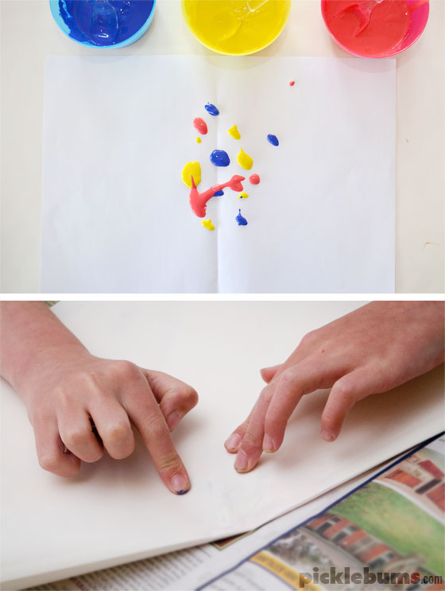
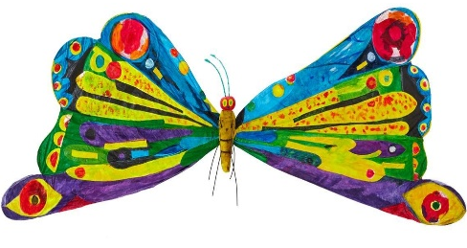
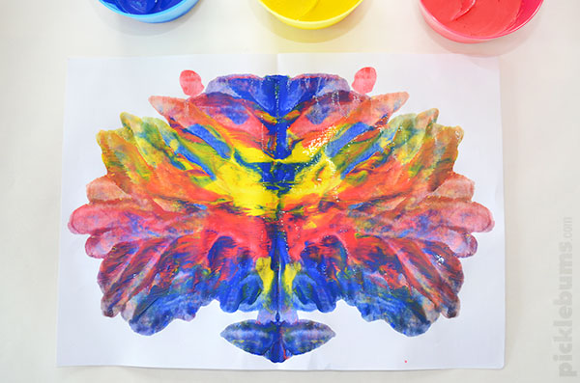
Paint a butterfly!
1. Blob paint!
2. Fold the paper
over and press!
3. Peel open to reveal your butterfly!

