Slide 1
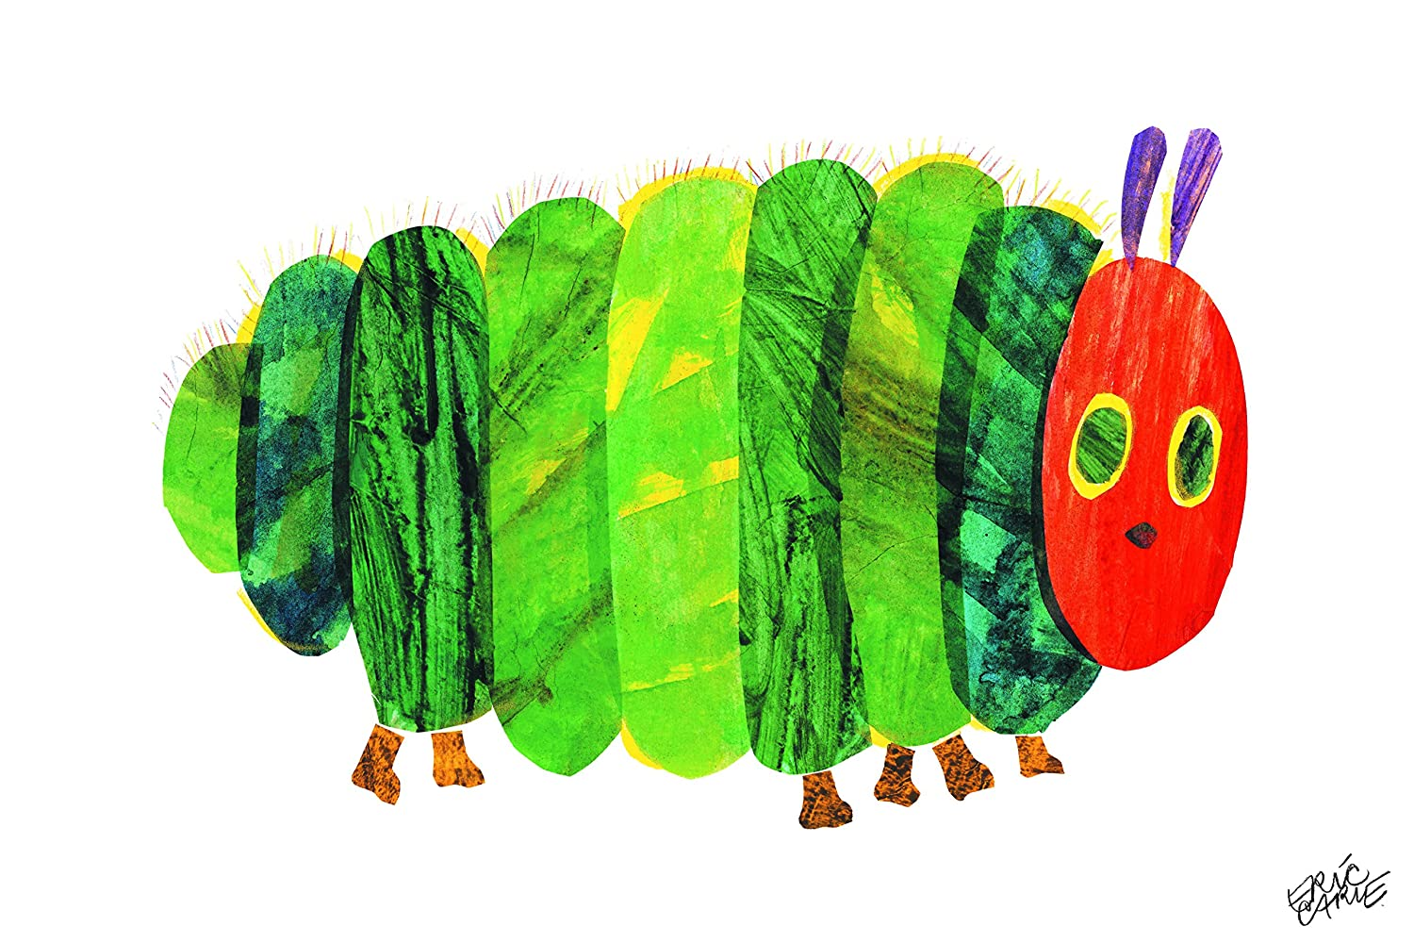
Panda Maths Activity: Week 4
This caterpillar is big.
This caterpillar is small.

Slide 2
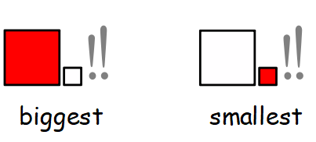
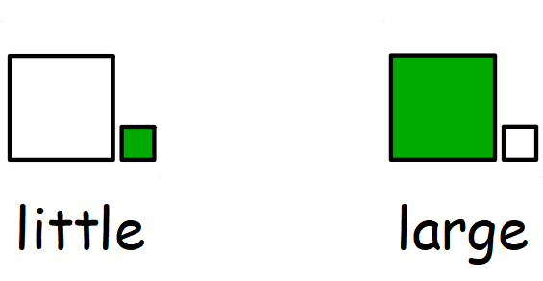
Encourage your child to look at both caterpillars and to point to the one that is the biggest and the smallest when asked.
Cut out and use these symbols – can your child match them to the correct caterpillar?
A bit harder:
Try using the words – large and little. Do they understand these to mean the same thing?
Extend this activity by labelling items around the house or sort a collection of toys by their size.

Slide 3
I can point to the caterpillar that is the biggest and the smallest when asked.

Slide 4
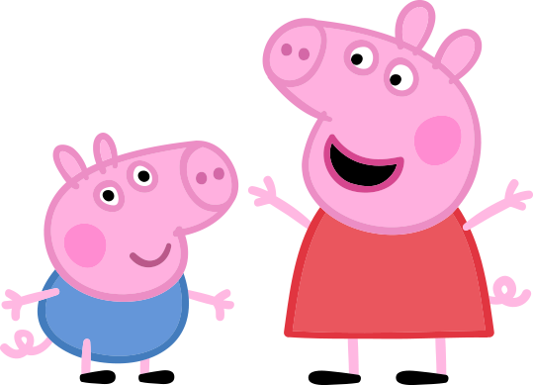
Ask your adult to help cut out the pictures of Peppa on this page
.
Can you sort the big and small Peppa Pigs and stick them into the two sets on the next page?
What else can you find that is big? What can you find that is small?

Slide 5
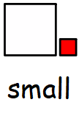
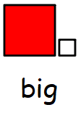

Slide 6
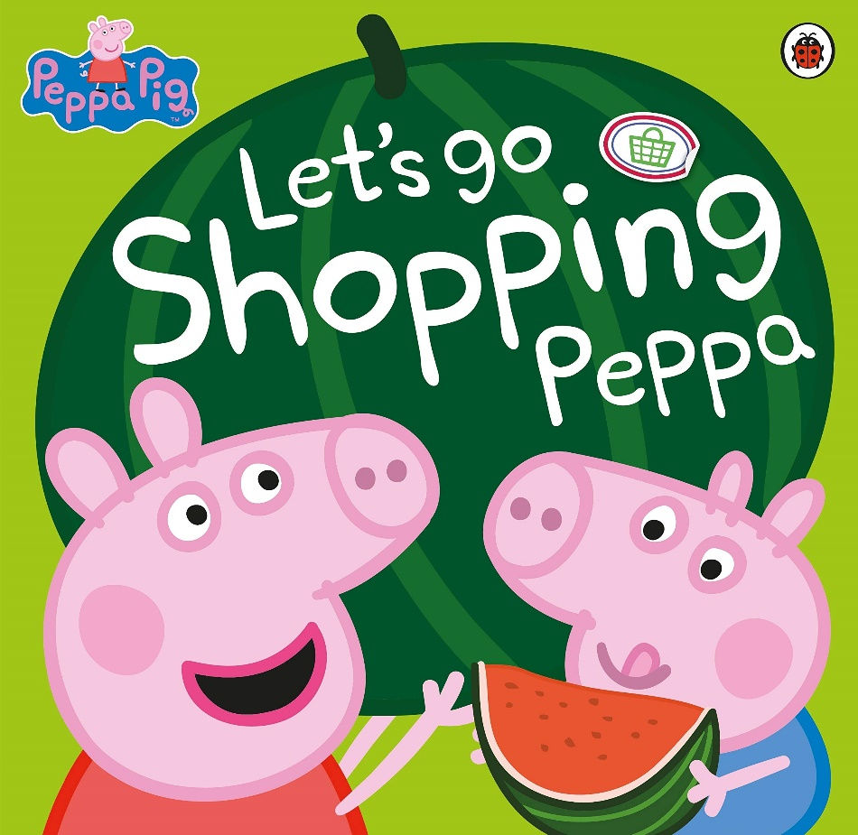
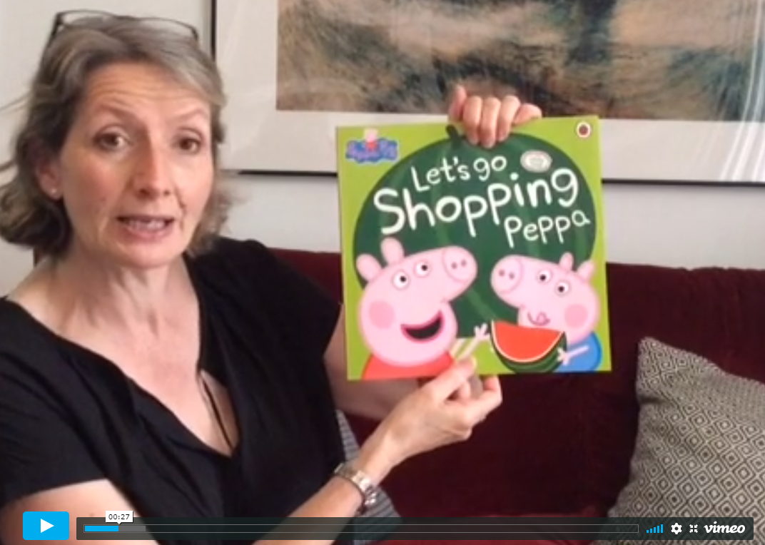
If you want some more Peppa Pig fun
you can listen to Cath read
‘Let’s Go Shopping Peppa’
or
you can watch the Peppa Pig Shopping episode on YouTube.

