Slide 1
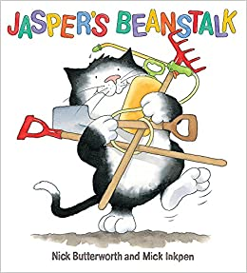
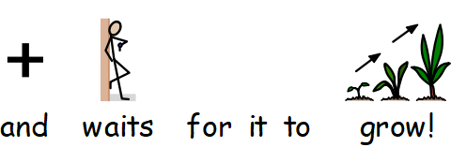
You can help your adult to read this story.
Maybe you can point to details in each picture like the cat, the moon or the watering can.
Or can you sign or say these words?
Share with your adult what you think might happen next in the story?

Slide 2
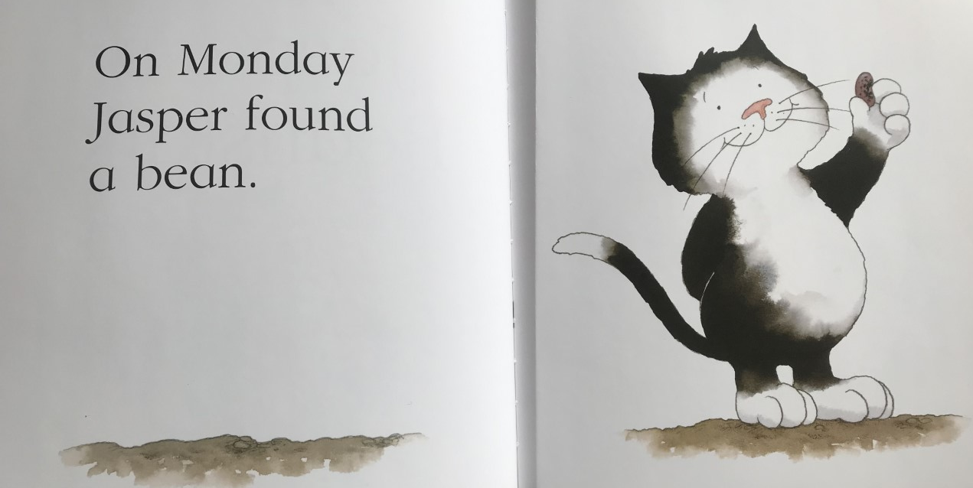
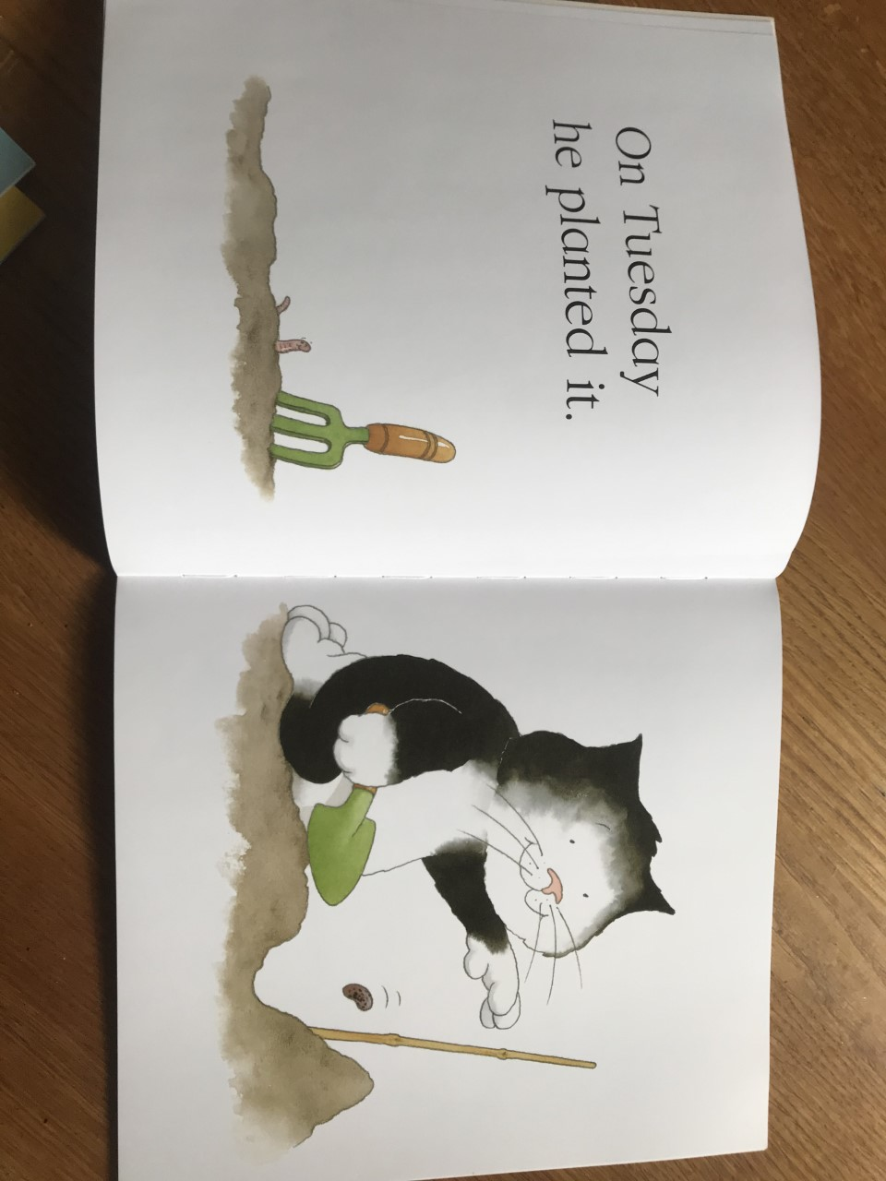
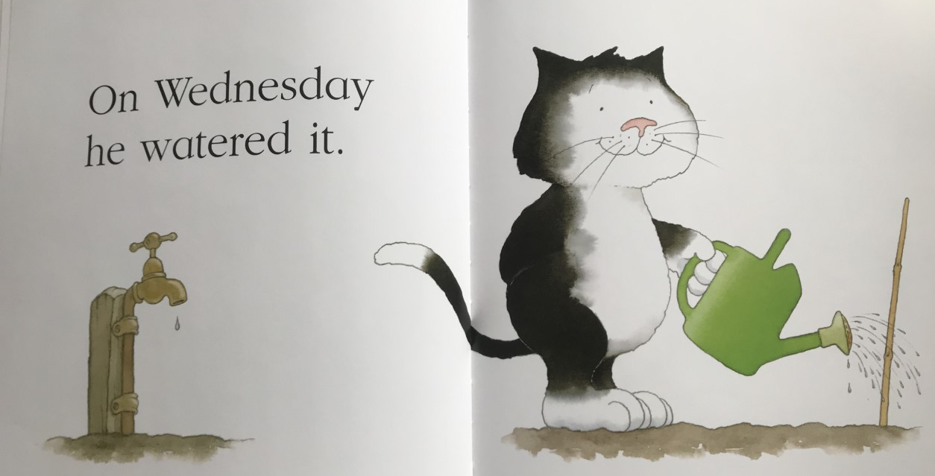
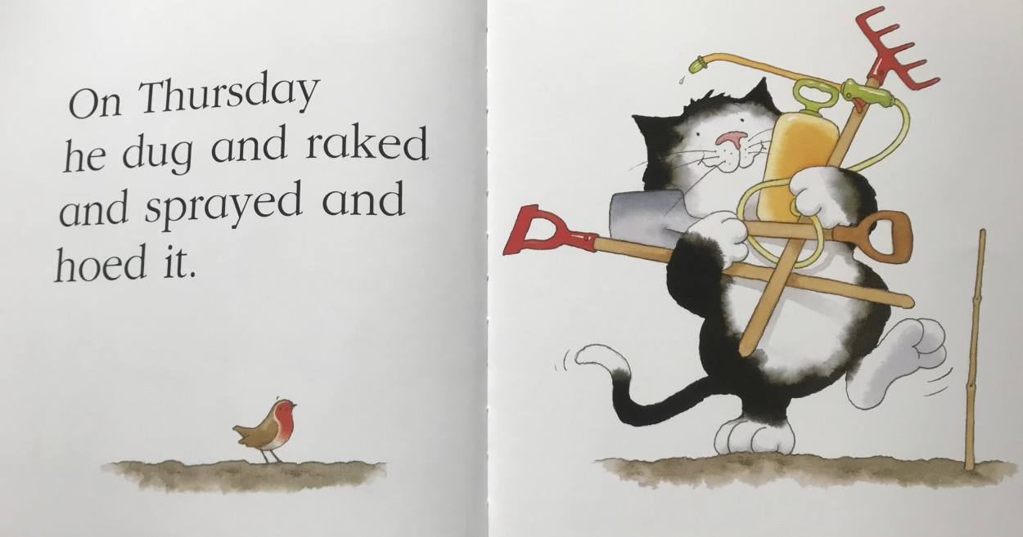
1.
2.
3.
4.

Slide 3
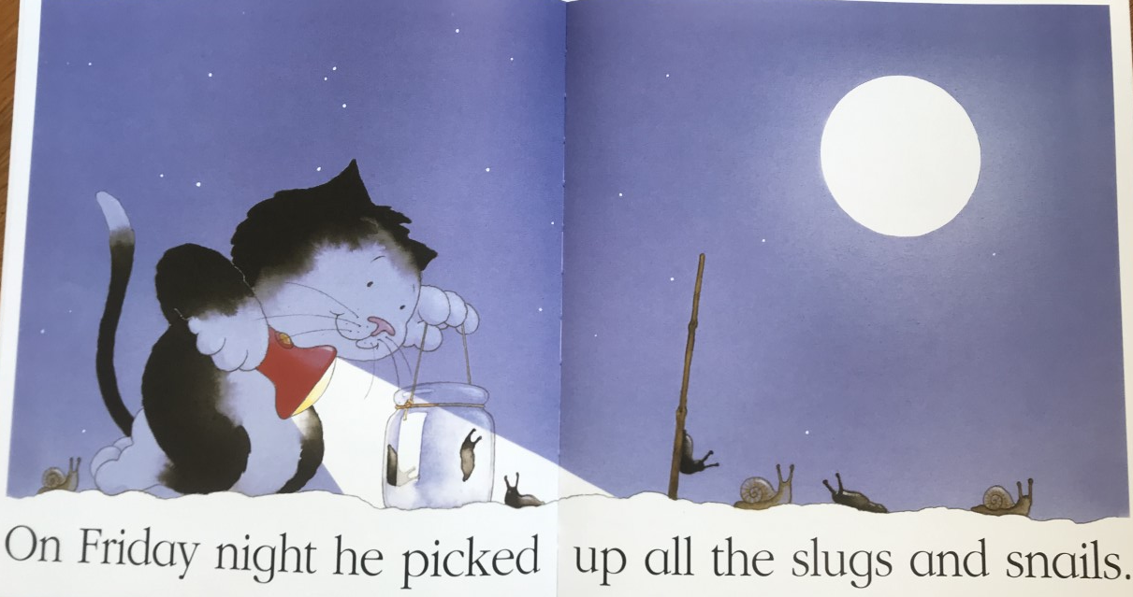
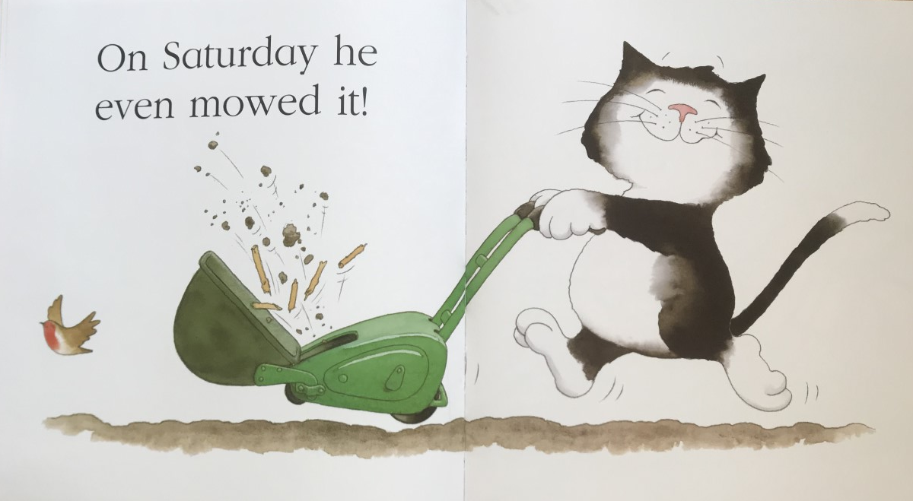
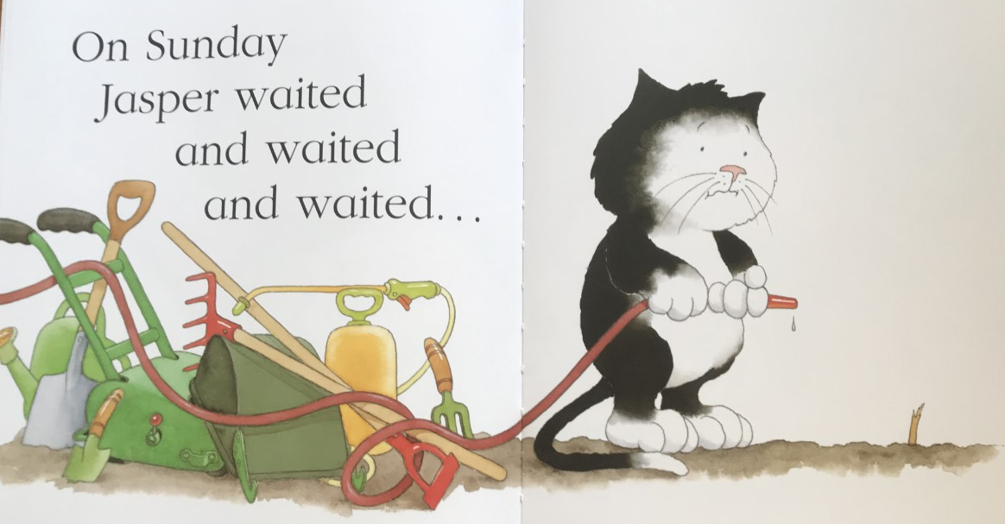
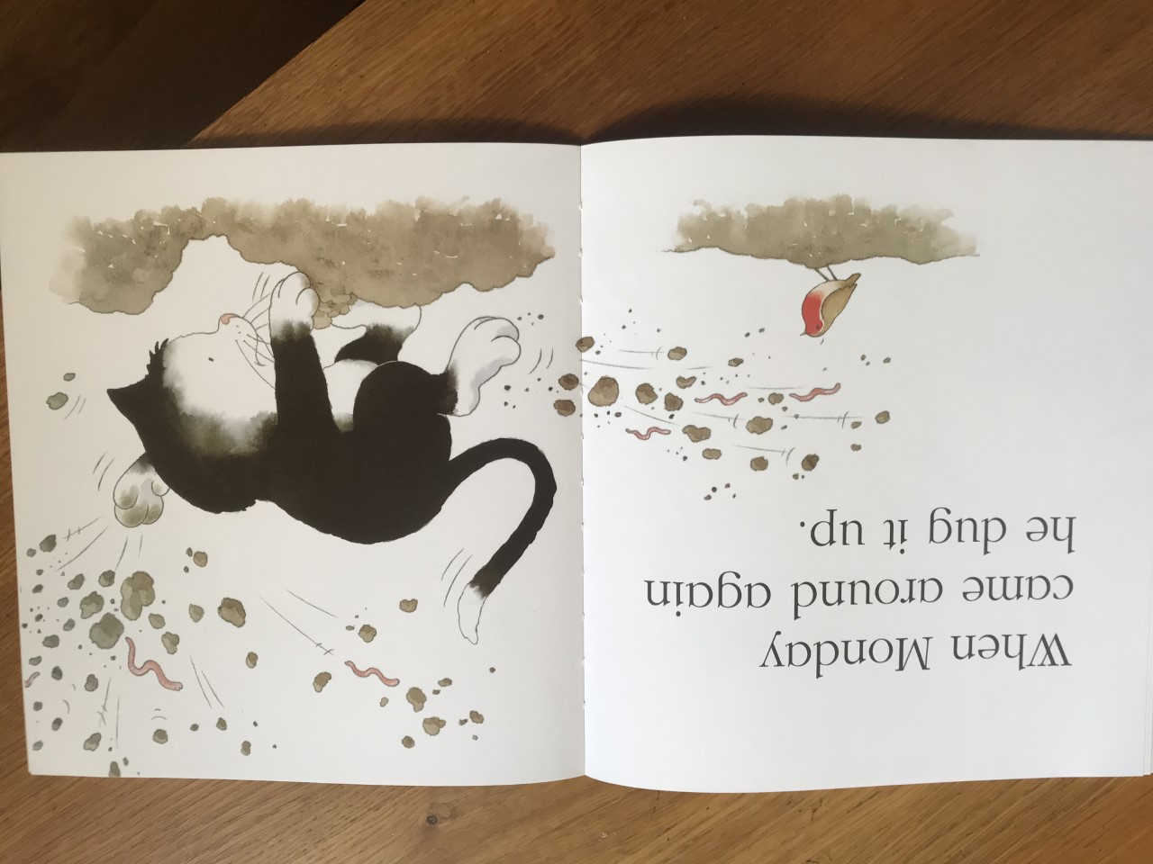
5.
6.
7.
8.

Slide 4
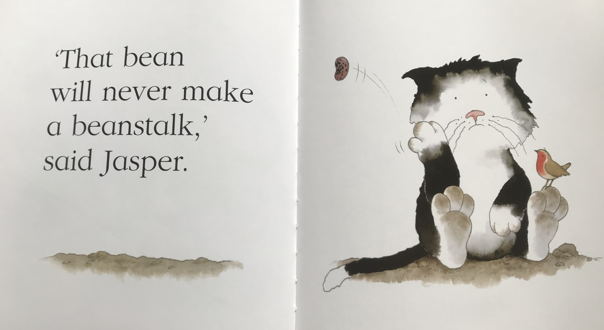
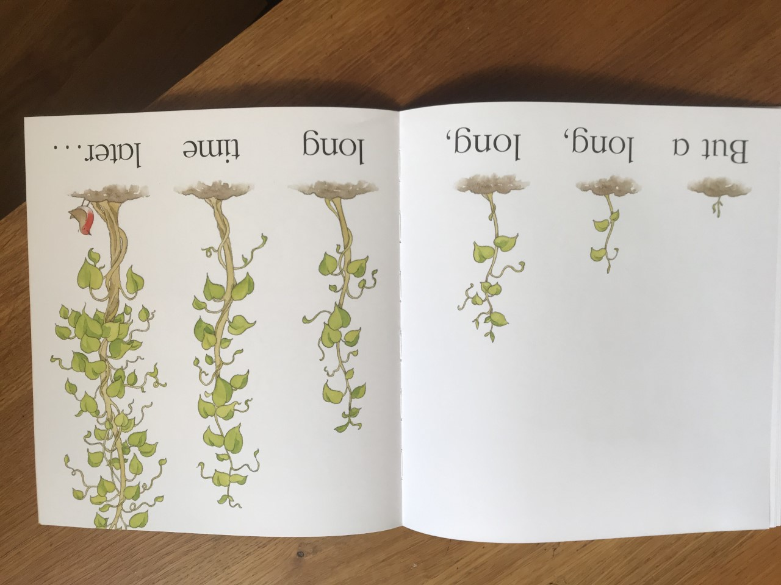
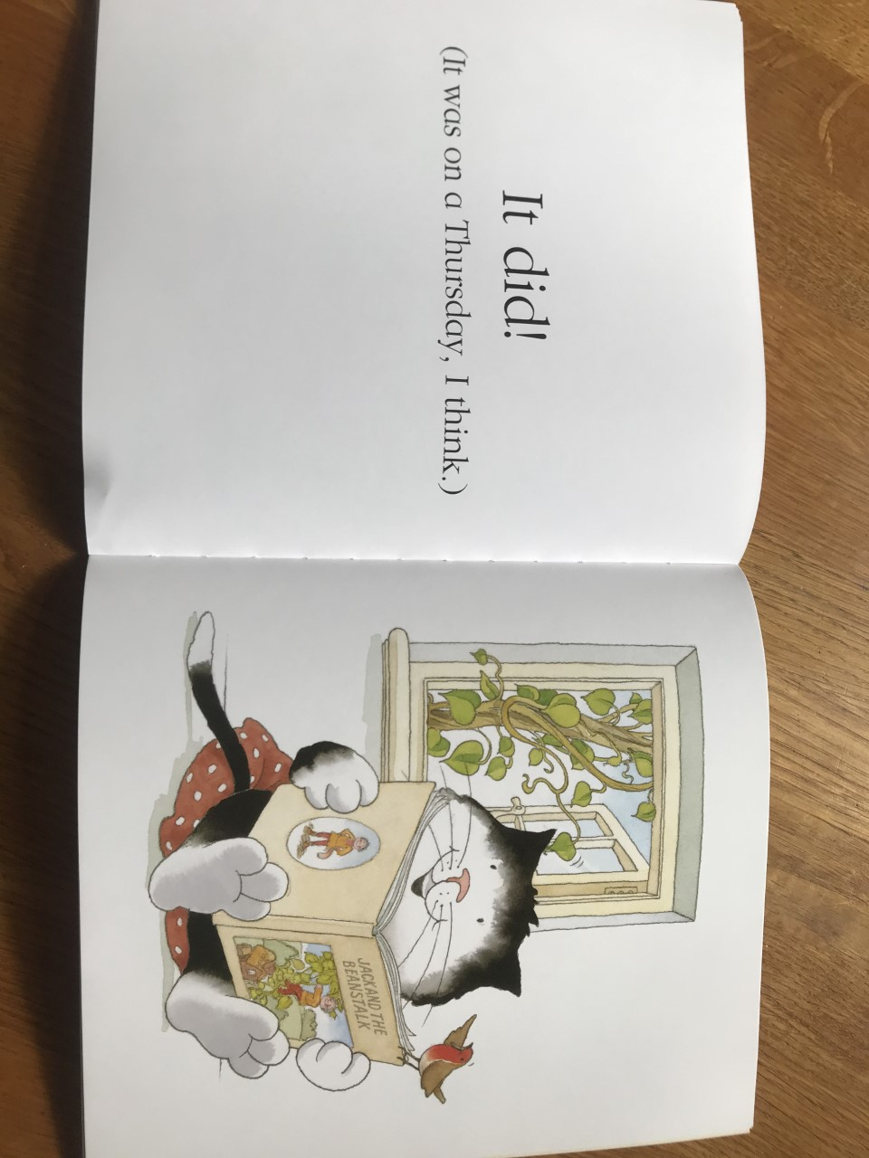
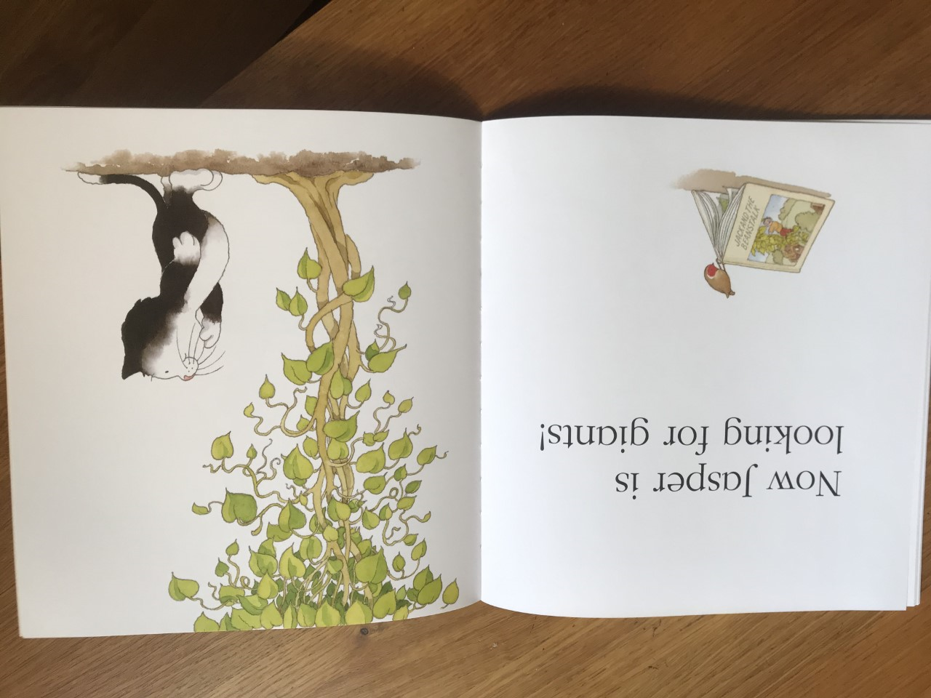
9.
10.
11.
12.

Slide 5
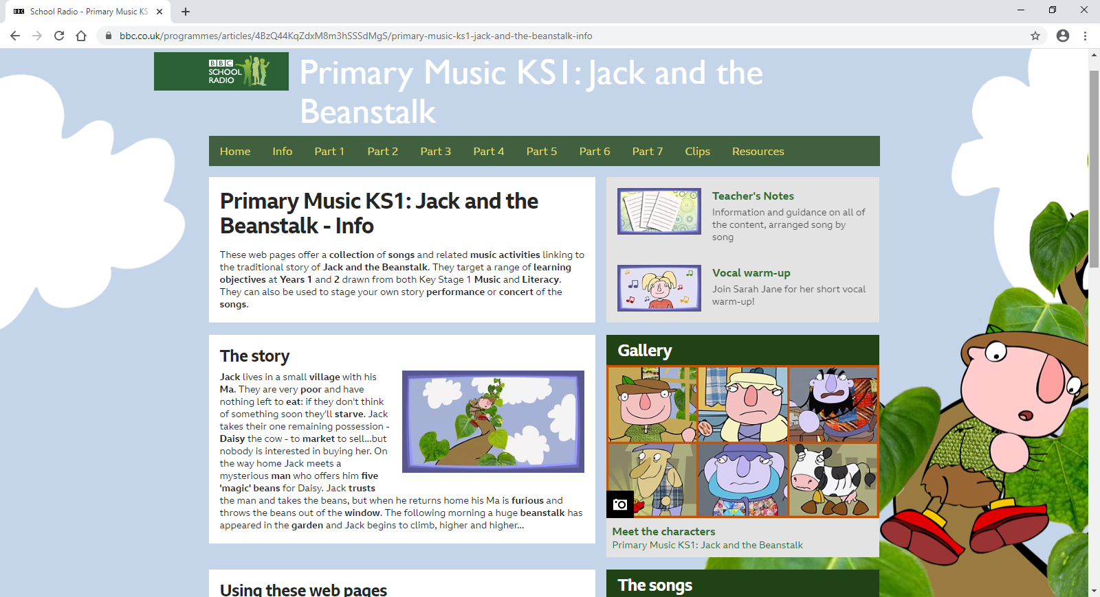
The story has a boy called Jack who grows a beanstalk like Jasper does.
He climbs up the beanstalk and finds a giant!
You might enjoy finding out more about this story?
Maybe you and your family can listen to the songs and the story on this site->
BBC School Radio.

