Slide 1
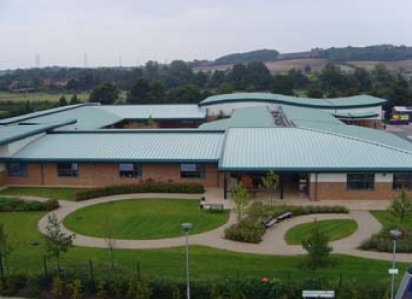
Granta School 2006
Granta was built 11 years ago and during this time we have had many children pass through our doors, they have each gained something very special from their time here.

Slide 2
One of the Major enjoyments for our children are the outside spaces.
They play with their peers on the climbing frame, trim trail, trikes and scooters
They play football and basket ball
They run and chase each other, expressing themselves through play in a safe environment.

Slide 3
Our Play Spaces
Sadly time has taken its toll on the areas and the equipment has been ‘much loved’

Slide 4
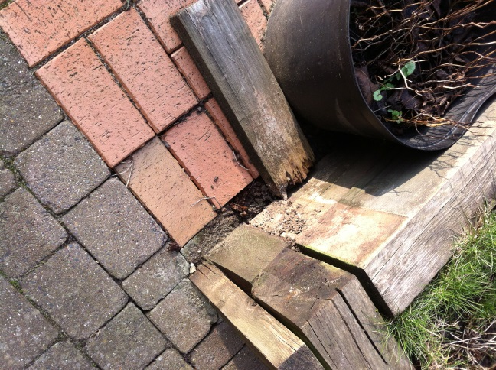
Courtyard raised beds Phase 1

Slide 5
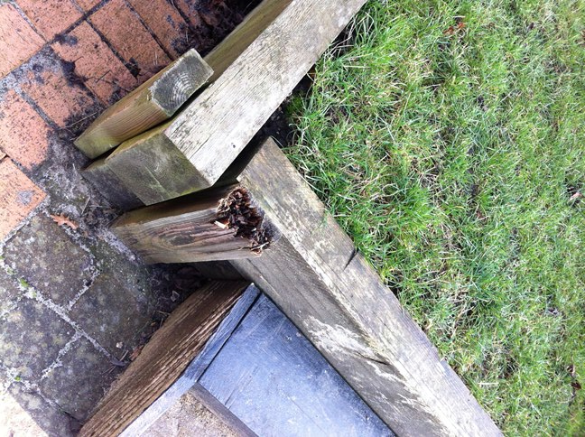
The raised beds surrounds are rotting and collapsing

Slide 6
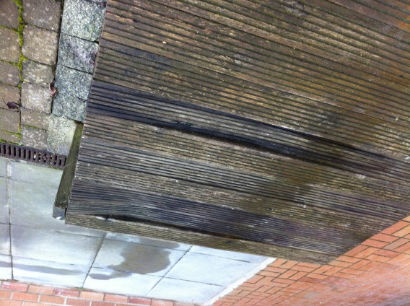
The decked bowling alley and stage is cracked and warped.

Slide 7
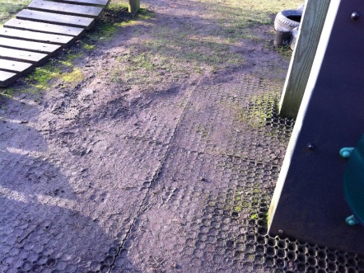
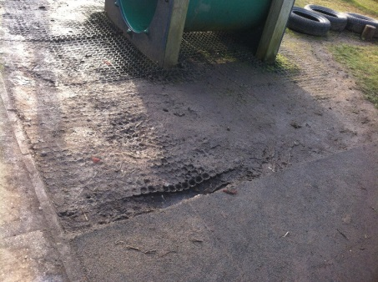
Key stage 2 Phase 2

Slide 8
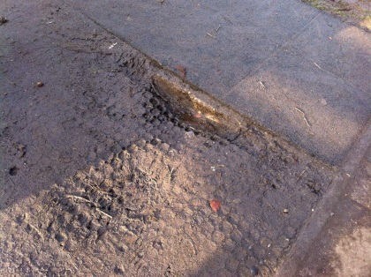
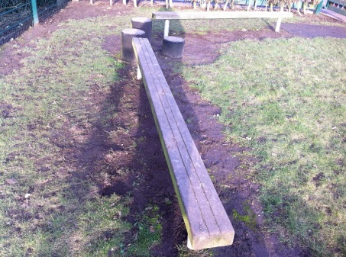
Mud glorious mud
Surfaces are uneven and dangerous especially for those in wheelchairs or visually impaired

Slide 9
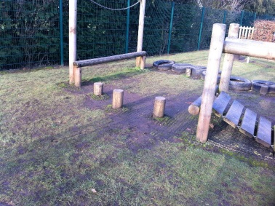
The trim trail is slippery and the tyre run is broken. The safety matting laid under the grass is now exposed and curling up

Slide 10
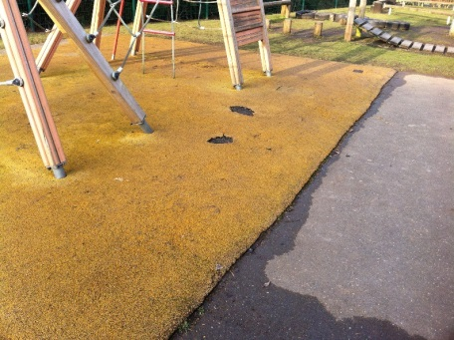
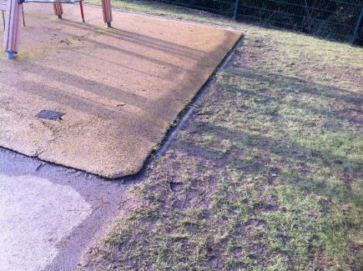
Key stage 2 phase 3
The soft play area is disintegrating and lifting away from the surface. The climbing frame has been repaired several time and is coming to the end of its use.

Slide 11
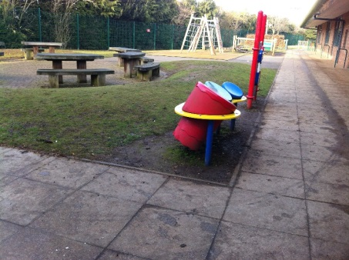
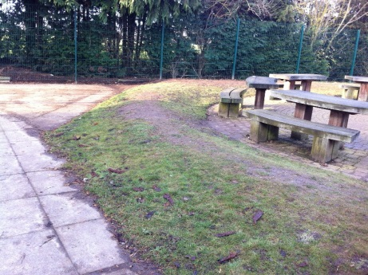
Phase 4
The undulating mounds have become mud slides and the outside class area is left abandoned.

Slide 12
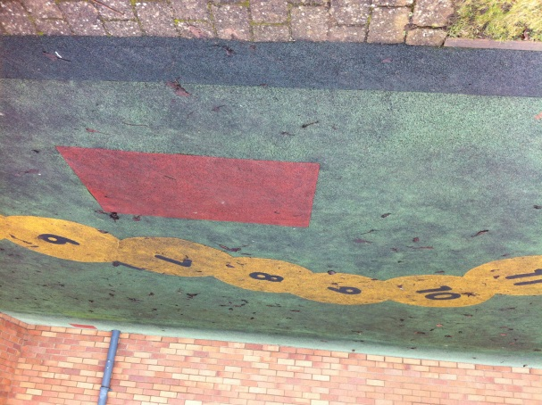
Soft play area Phase 5
The soft play matting is extremely slippery and patched and during the winter this freezes over

Slide 13
Our Visions for the future
With the help of some friends we may be able to realise our visions for the play areas over the coming years coming years.
Phase 1 Remove/replace wooden sleepers, Adaption of bowling alley into boat/seating area & repair to drain, uneven surface. Use soft planting to enhance the features and provide sensory experiences for the early years and key stage one children
Phase 2 Jet wash all equipment, Paint anti slip paint on bridge, replace tyres with a tunnel, level the ground and replace grass with Astro turf. This would make the area useable all year round and reduce the slip hazards associated with the mud

Slide 14
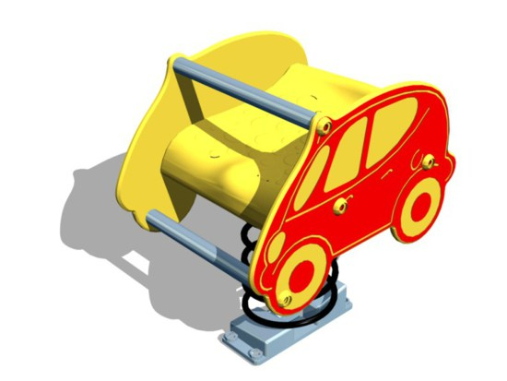
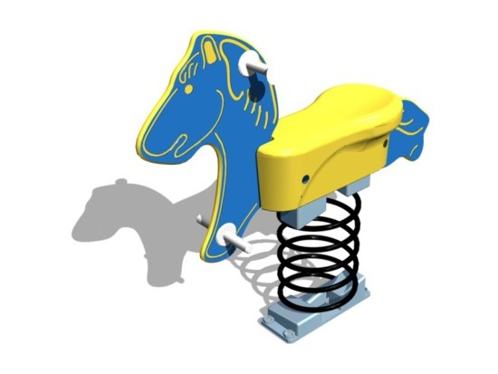
Phase 3
Remove Climbing Frame, remove soft play surface and replace with Astro Turf and replace Climbing Frame with Springers of various types to make this a bright inviting area

Slide 15
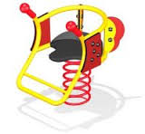
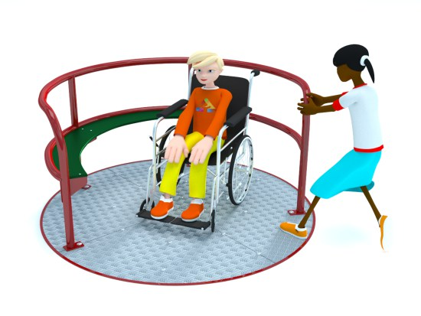
Phase 4
Remove outside classroom, Level area , Replace grass with Astro Turf and replace with disabled access equipment, making the area accessible for all our students. This area is situated next to the phase 3 area which would make a fully inclusive area for all our students.

Slide 16
Phase 5
Remove soft play surface and replace with Astro Turf, Install trim trail equipment

Slide 17
Thank you for watching our presentation
A full report is available

