Slide 1
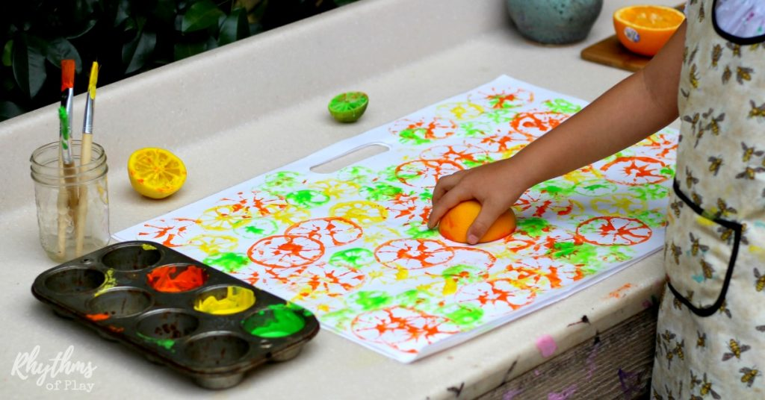
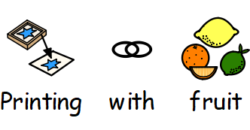
Panda Activity: Week 4
June 22nd 2020

Slide 2
